Slide 1
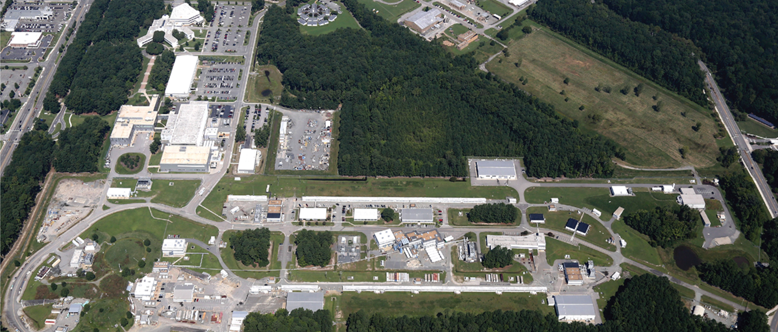
Thomas Jefferson National Accelerator Facility
Pre-Proposal Conference
July 18, 2024

Slide 2
General Information
This Zoom Webinar is being recorded.
The Q&A feature has been disabled.
– Questions must be submitted to TJNAFcompetition@science.doe.gov.
The Chat feature is available for technical issues only.

Slide 3
Agenda
Welcome
TJ lab Site Updates
Procurement Information
Adjournment

Slide 4
Site Updates
Craig Ferguson, Site Office Manager
July 18, 2024

Slide 5
Site Updates
Noteworthy Project Achievements:
Electron-Ion Collider Project (partnership with BNL): Obtained CD-3a (long lead procurements) on March 28, 2024
Measurement of a Lepton-Lepton Electroweak Reaction - MOLLER Project: Obtained CD-2/3 approval (project baseline and authorization to begin construction) on May 28, 2024
End Station Refrigerator 2 General Plant Project (GPP): Threshold Key Performance Parameter achieved May 21, 2024
Other Project Changes:
Thomas Jefferson Infrastructure Improvement Project: CD-1 and project overall delayed until FY27 due to funding
Cryogenic Test Facility Upgrade GPP: Project completion moved out a year to November 2025 due to supply chain issues -cold box
Central Utility Plant (CUP) Chiller Upgrade GPP (JLab Funded): TPC increased from $4.2M to $5.5M and the completion date is delayed from Q2FY25 to Q4FY25 - supply chain issues
Site At Large:
Currently in planned accelerator shutdown
Laboratory in a Hazardous Energy Control pause due to inadequate implementation of work planning and control/ISM
New Safety Analysis Document drafted, reviews planned in support of DOE O 420.2D implementation through March 2025
Held public open house on June 8, ~9000 attendees, celebrating 40 years
New Laboratory Director starting August 2024

Slide 6
Procurement Information
Brandon Whittier, Contracting Officer
July 18, 2024

Slide 7
Procurement Information
The Office of Science is committed to ensuring a fair, full and open competition.
Major Goals
  Maximize competition
  Select the best contractor
  Improve the process

Slide 8
Source Evaluation Board
Source Evaluation Board (SEB) appointed
  DOE employees
  Voting and non-voting members
SEB is responsible for all aspects of the procurement
  Developed and issued the RFP
  Responding to questions
  Evaluating the proposals
Source Selection Authority (SSA) will make selection
We are in the midst of an active contract competition. Conversations and communications between SEB members and prospective offerors or other interested parties regarding this acquisition outside of the approved methods of communication are prohibited.

Slide 9
What We’ve Done
Announced the intent to compete – October 24, 2023
Launched competition website – February 6, 2024
Issued Request for Information (RFI) – February 13, 2024
Issued Expression of Interest (EOI) notice – February 28, 2024
Held Informational Meeting – March 27, 2024
Released RFP – July 3, 2024
Pre-Proposal Meeting – July 18, 2024 (Today)
  Questions Due – September 20, 2024
  Proposals Due – September 30, 2024, 5PM ET

Slide 10
Competition Website
https://science.osti.gov/Acquisition-Management/M-and-O-Competitions/TJNAF
Official source of information and primary means of communication
Contains information and direction critical to the competition and all official documents
  RFP
  Questions and Answers
  Event information (e.g., registration instructions, presentations, attendee list, etc.)
  Document library
Interested parties are responsible for frequently monitoring the website for information, notices, and updates regarding the solicitation.

Slide 11
RFP Overview
Proposal Submission Instructions – Section L
  3-Volume proposal
  Acknowledgment of amendments
  Volume II page limitation, Section L.1, para. (f)
Evaluation Factors – Section M
  Capabilities and Approach Factors
    Science Vision and Implementation Plan
    Laboratory Operations
    Management Approach
    Past Performance
    Transition Plan
  Cost evaluation

Slide 12
RFP Highlights
Performance Fee – Section B.3
  Max fee
  Fee base
  Transition is cost only, no fee
  2025, 2026, 2027, and 2028 potential forfeiture up to $300K for each Key Personnel departure
Allowability of Subcontractor Fee – Section B.4
  How fee is shared within a Teaming Arrangement is at the contractor’s discretion

Slide 13
RFP Highlights
Selected Highlights in Section L
  Electronic submission only (FedConnect) (L.1 & L.15)
  Key persons may hold joint appointments (L.4)
  Past Performance (L.5)
    Recent definition
    Relevance definition
    Section L, App. 1, Past Performance Info Form
  Presenters and Attendees at Oral Presentation (L.8)
  Intent to submit a proposal (L.14) (July 25, 2024)

Slide 14
An Important Note - System for Award Management
Please register in SAM
Offerors are required to be registered in SAM when submitting a proposal, and at award
Consider processing time when registering.
See https://www.sam.gov for registration information.

Slide 15
Another Important Note – FedConnect.net
Please register in FedConnect
12-Digit SAM UEI is required for FedConnect registration
Consider processing time when registering
https://www.fedconnect.net/FedConnect/PublicUserRegistrati on.aspx for registration information.
Questions regarding FedConnect are addressed directly to FedConnect - instructions are on the FedConnect website

Slide 16
Questions and Answers Protocol
Questions will not be answered verbally (except those received by pre-proposal conference deadline of July 15)
A careful and deliberate Q&A process has been established to
  Protect the integrity of the procurement process
  Ensure the consistent transfer of information
  SC will meaningfully consider all questions submitted prior to the cut-off but may not provide a response
  When responding, SC may summarize or combine questions
Questions must be submitted to TJNAFcompetition@science.doe.gov
All responses will be prepared by the SEB and posted on the competition website
10 Day Cut-off (Friday, September 20, 2024)

Slide 17
Questions/Answers
1) Can DOE provide information on any Human Resource Information System (HRIS), Enterprise Resource Planning (ERP), or Enterprise Accounting system currently in use at TJNAF? Also, will the winning Contractor be required to continue using these systems if they win the award?
Information on TJNAF’s current Human Resource, Resource Planning, and Accounting Systems will be posted on the competition website. The winning contractor will not be required to use these systems.
2) Can DOE provide information on the benefits package provided to TJNAF employees and that the winning Contractor will be required to provide if they win the award?
Information regarding the incumbent’s benefit packages will be provided to the selected contractor during transition. The winning contractor will be required to provide equivalent benefits in accordance with Provision L.25 TJNAF Personnel Information, Section (c)(2) which states, “The contractor shall provide retained incumbent employees equivalent pay for at least the first year of the contract and equivalent benefits to those provided by the incumbent contractor.”

Slide 18
Questions/Answers
3. If a Subcontractor that was part of a teaming arrangement is not sharing in the M&O prime contract fee structure, may that subcontractor include a profit in the subcontract as an allowable expense?
No, in accordance with B.4, “If a Contractor is part of a teaming arrangement, the team shall share in this contract fee structure, at the discretion of the Contractor, and separate additional subcontractor fee for teaming partners shall not be considered an allowable cost under the contract. If a subcontractor, supplier, or lower-tier subcontractor is a wholly owned, majority owned, or affiliate of any team member, any fee or profit earned by such entity shall not be considered an allowable cost under this contract unless otherwise approved by the Contracting Officer.”

Slide 19
Questions/Answers
4. Section L.5 defines relevance as in excess of $25 million in average annual research and development costs. If a member of the Offeror is a university bringing critical skills and qualifications to TJNAF, would the Government accept a contract that was more similar to the size of the work they will be performing? This would enable reviewers to evaluate relevance based on the institutional expertise they are bringing. Alternately, could a university Offeror provide past performance against R&D expenditures that are self-funded or funded by other agencies within a specific domain? Please advise.
L.5 defines "size- in excess of $25 million in average annual research and development (R&D) revenues/costs (i.e., basic and applied research and engineering development)." In accordance with Section M.4, paragraph (d), “…if the Offeror does not have a record of recent and relevant past performance information on contracts similar to the Statement of Work or past performance information is otherwise not available, the Offeror will not be evaluated favorably or unfavorably for past performance. " The past performance information submitted shall be on recent and relevant contracts. The RFP does not specify the source of the contract funding.

Slide 20
Tentative Schedule (SUBJECT TO CHANGE)
Pre-Proposal Conference – Today
TJNAF Site Tour – July 23, 2024
Q&A Cut-off – September 20, 2024
Proposals Due – September 30, 2024, 5PM ET
Oral Presentations – approximately 4 weeks after receipt of proposals (notice coming o/a October 15, 2024)
Award – 2nd quarter FY25
– Anticipate award without discussion; however, DOE reserves the right to hold discussions if deemed necessary.
Transition – Begins 2nd quarter FY25
Start new contract – June 1, 2025

Slide 21
SC appreciates your feedback over the last several months, and looks forward to conducting this acquisition for a
TJNAF M&O contractor.
REMINDER
Questions must be emailed to: TJNAFcompetition@science.doe.gov.

