Slide 1
PMCDP Update
FPD Forum May 2023
Alex Bachowski
Office of Project Assessment (OPA)

Slide 2
Certification Equivalency Guide (CEG)
The detailed requirements for PMCDP are included in the Certification Equivalency Guide (CEG) available in ESS/PMCDP menu or on PM Max at https://community.max.gov/download/attachments/1131743009/Certification%20and%20Equivalency%20Guidelines%20%28CEG%29.pdf?api=v2.
Be sure to have the latest CEG when completing your application!
The CEG gets updated often so do not rely on old PDFs.
CEG was last updated in February 2023. Three (3) updates were made.

Slide 3
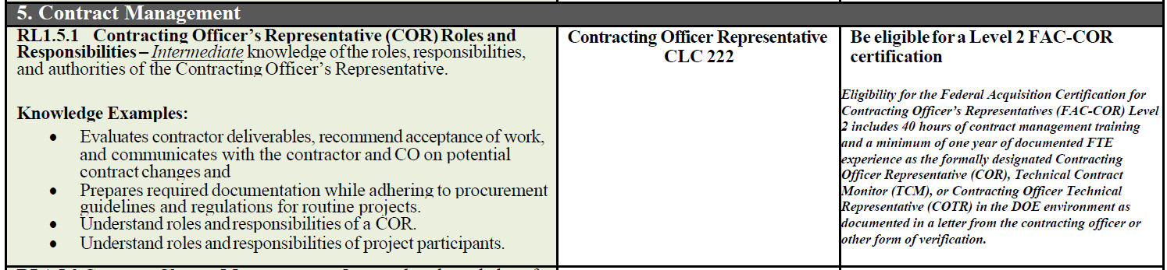
Update #1
Statement added for the Contracting Officer Representative (COR) Level I Competency Fulfillment (RL1.5.1):
Eligibility for the Federal Acquisition Certification for Contracting Officer’s Representatives (FAC-COR) Level 2 includes 40 hours of contract management training and a minimum of one year of documented FTE experience as the formally designated Contracting Officer Representative (COR), Technical Contract Monitor (TCM), or Contracting Officer Technical Representative (COTR) in the DOE environment as documented in a letter from the contracting officer or other form of verification.

Slide 4
Update #1
The statement is added for Level 1 candidates in order to guide them towards the Level 2 and 3 COR requirements.
All FPDs looking to achieve Level 2+ certification must work with their Supervisor to gain COR experience.
  Typically, FPDs are assigned as COR on utility contracts since SC does not normally have COR’s on capital asset projects.

Slide 5
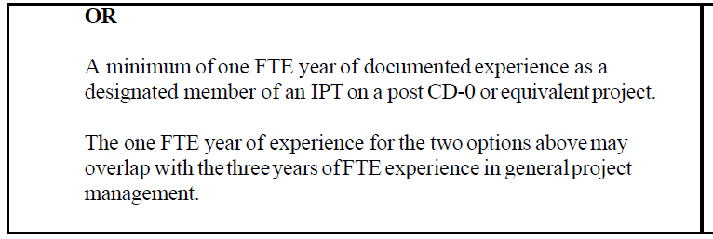
Update #2
Expand Level I Work and Experience (WEL1.2) designation from “as the designated project engineer” to “as a designated member of an IPT.”
Candidates must ensure they have documented proof of being a “designated member of an IPT” which could be a PPEP/PEP (or other formal project documentation) or appointment letter from their Supervisor.

Slide 6
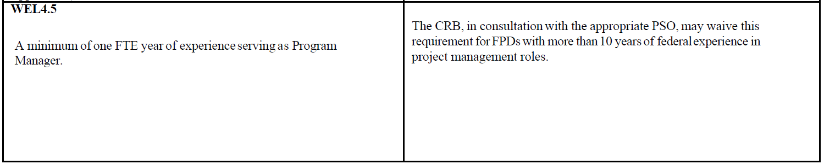
Update #3
Remove Level IV Work and Experience (WEL4.5) in consideration of the new DOE hybrid work model where many DOE HQ employees either telework or are on remote work.
The 90-day formal detail at DOE HQ was removed from WEL4.5. However, the experience serving as a Program Manager remains.
For those on the cusp of Level 4 certification, it is recommended to put in for it now in case this requirement is added back in given the potential for a Fed-wide telework posture change in the near future.

Slide 7
ESS Application
The FPD Application in ESS is outdated and based on an old CEG.
DOE PM is working on updating the application in ESS so it matches the current CEG.
For now, refer to the latest CEG for the actual requirements.

Slide 8
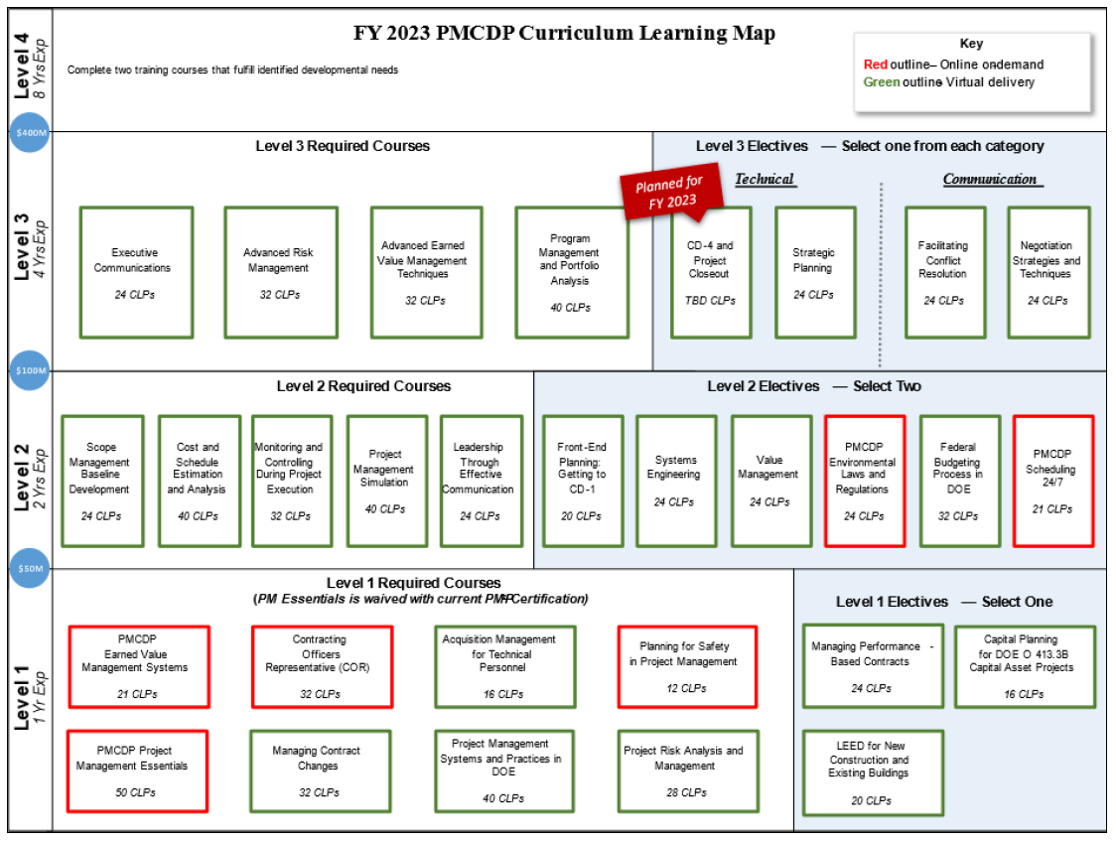
PMCDP Map

Slide 9
Questions?

