Slide 1
Committee to Assess the Current Status and Future Direction of High Magnetic Field Science in the United States
18 May 2012
User Facilities in
DOE’s Office of Science
Dr. Patricia M. Dehmer
Deputy Director for Science Programs
Office of Science, U.S. Department of Energy
http://www.science.energy.gov/sc-2/presentations-and-testimony/

Slide 2
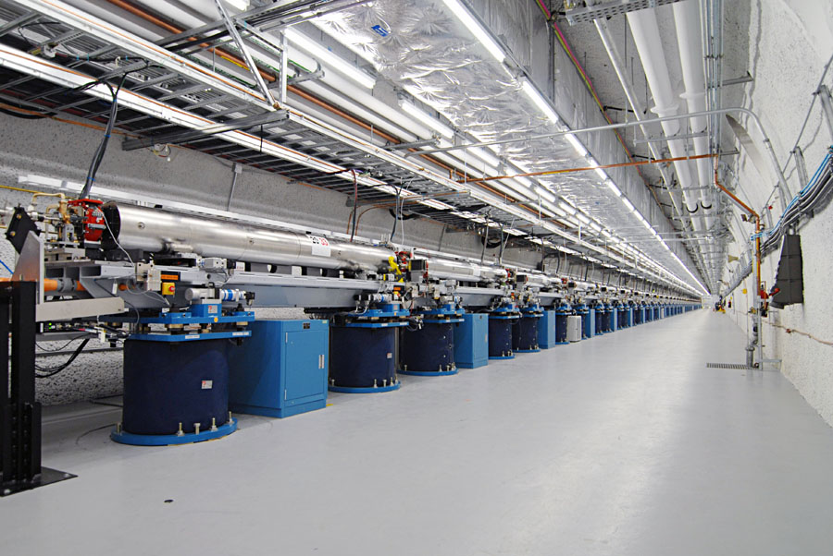
Office of Science (~$5B/year)
  25,000 Ph.D. scientists, graduate students, undergraduates, engineers, and support staff at more than 300 institutions
  32 national user facilities serving more than 26,000 users each year
  45% of Federal support of basic research in the physical sciences
  100 Nobel Prizes during the past 6 decades—more than 20 in the past 10 years
The undulator hall at the Linac Coherent Light Source, SLAC, 2011.

Slide 3
Research and Facilities in the Office of Science
All Other
Funding = $5B
Major Items of Equipment
  Support for 25,000 Ph.D.s, grad students, undergrads, engineers, and support staff
Facility Construction
Research
  The world’s largest collection of scientific user facilities with over 26,000 users /yr
Facility Operations

Slide 4
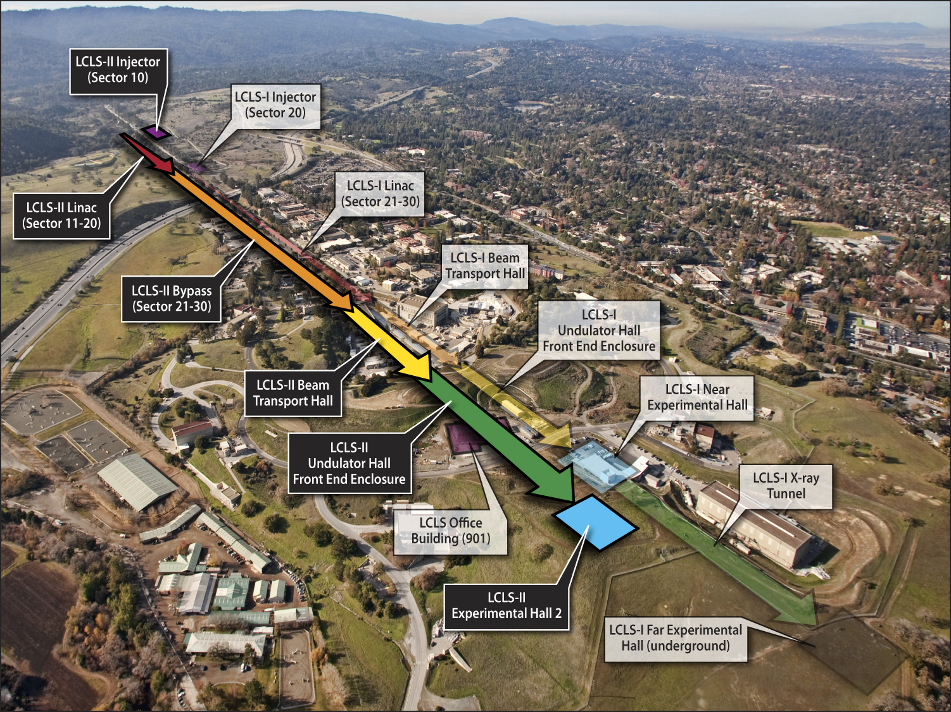
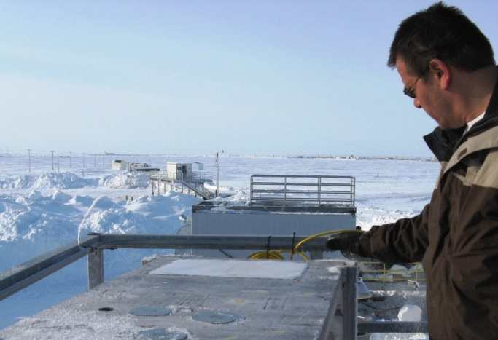
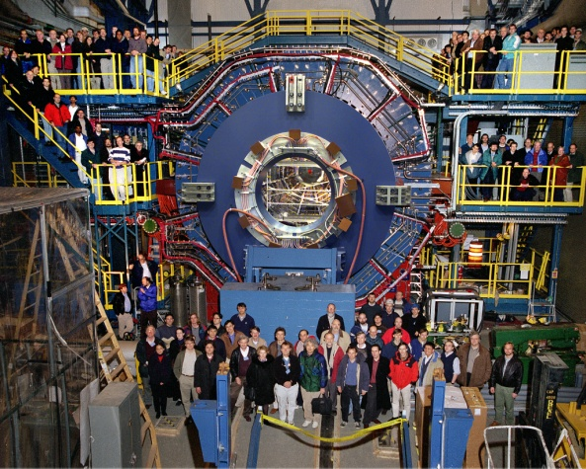
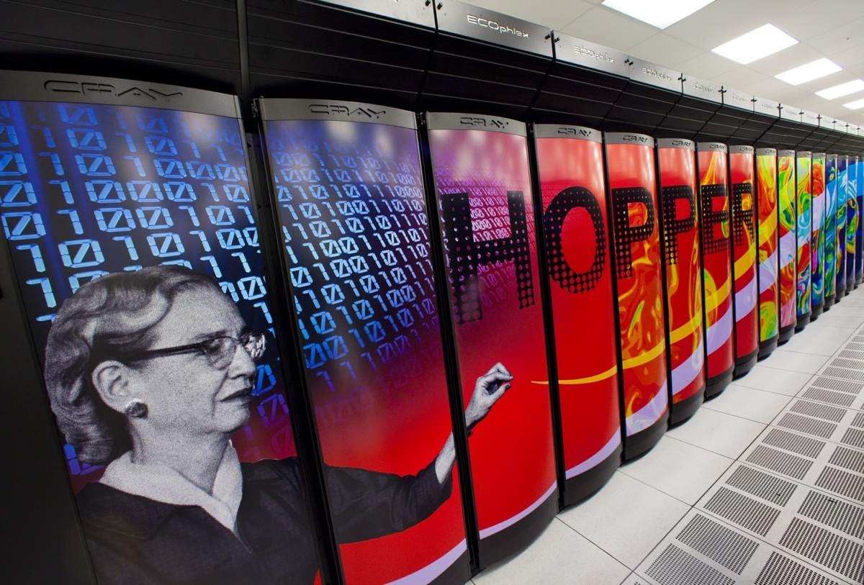
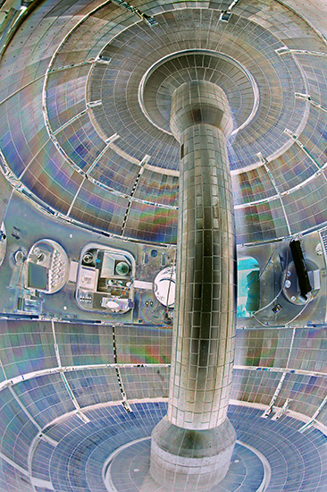
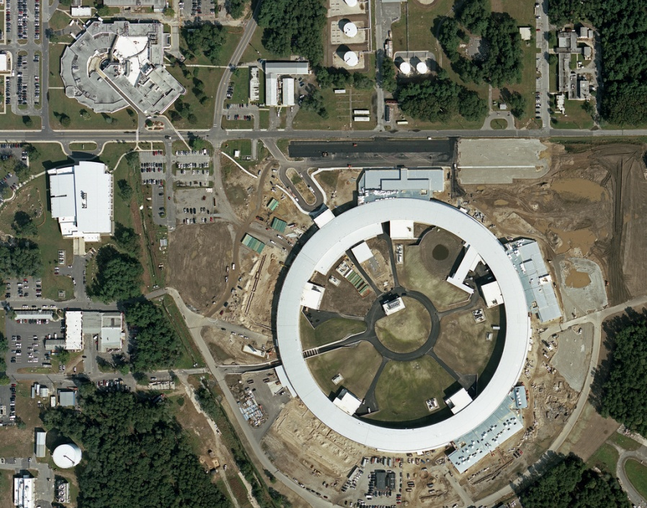
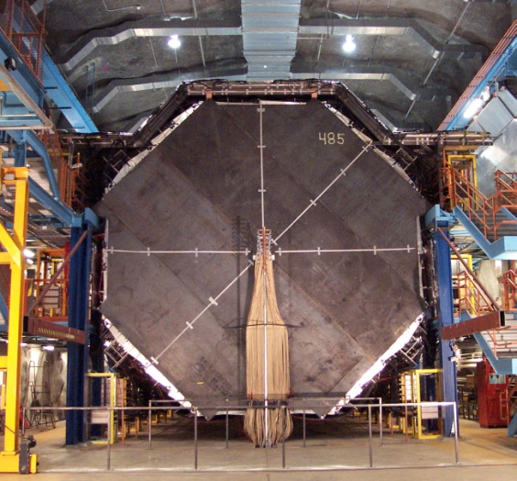
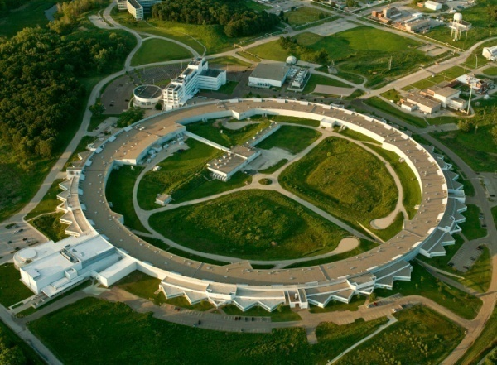
Some of the 32 Office of Science User Facilities
NSLS
NSLS-II
LCLS, SLAC; ARM, North Slope of Alaska; STAR Detector at RHIC, BNL; NSTX, PPPL; APS, ANL; MINOS far detector, U.Minn/FNAL; NSLS-II, BNL, NERSC Computing Center, LBNL

Slide 5
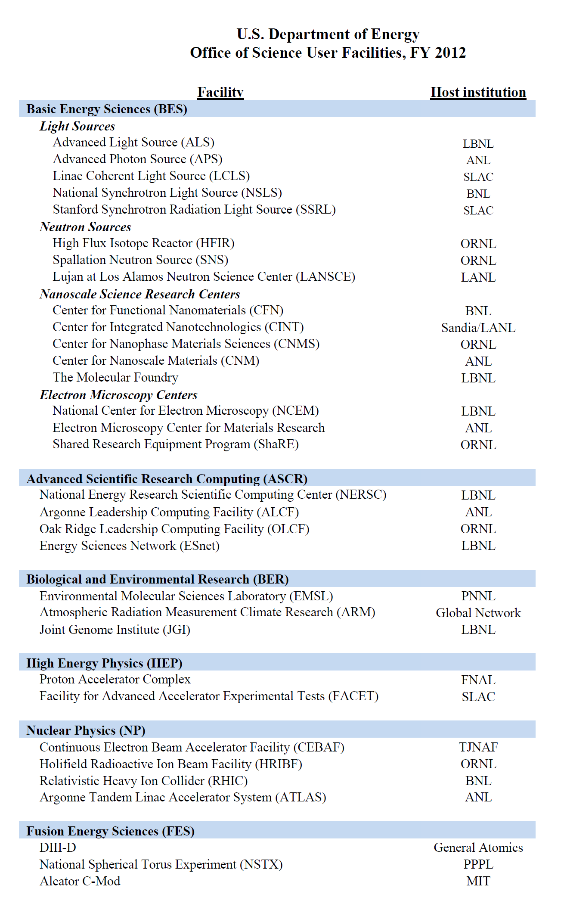
Office of Science User Facilities, 2012

Slide 7
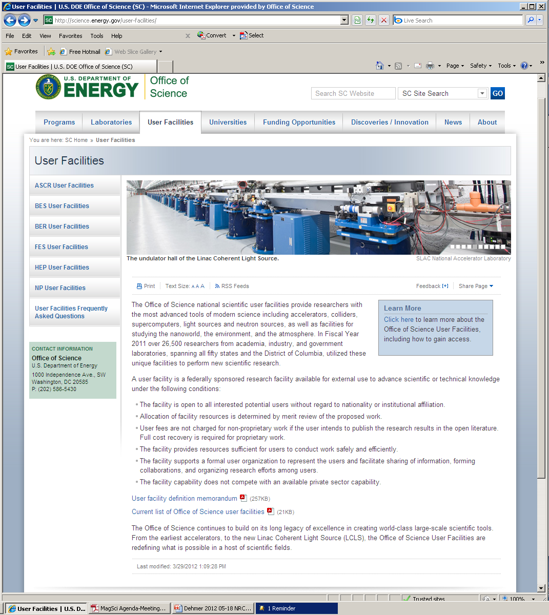

Slide 8
Evaluation for the BES Facilities
Annual (rare), biennial, or triennial (common) external peer review to assess:
  Impact of science, in the aggregate
  Service to a big, happy scientific community
Examination/interpretation of data from the Annual Facilities Questionnaire
  User demographics
  Operations data
  Budget data
  Summary of user satisfaction mini survey

Slide 9
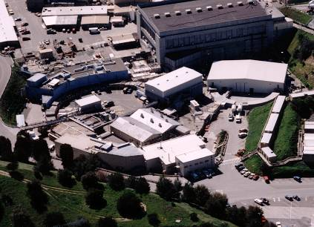
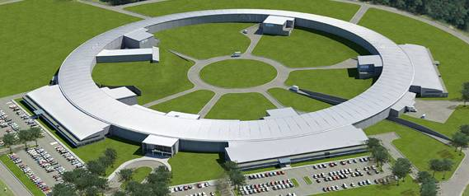
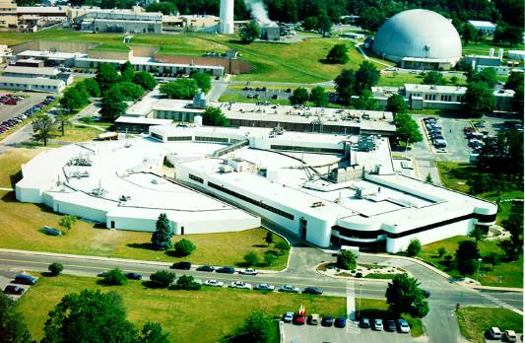
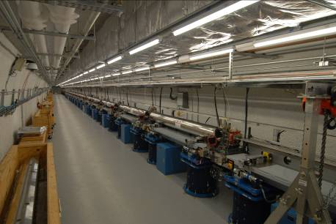
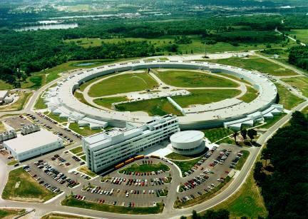
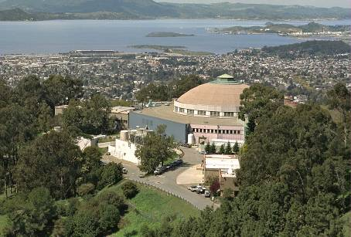
Synchrotron Light Sources
NSLS-II 2015
SSRL 1974 & 2004
NSLS 1982
APS 1996
ALS 1993
LCLS 2009

Slide 10
Users by Discipline at the Synchrotron Light Sources

Slide 11
Users by Employer at the Synchrotron Light Sources

Slide 12
Characteristics of Users at the Synchrotron Light Sources in FY 2010

Slide 13
Distribution of Technical Quality of 171 Beamlines (2005)
10
30
21
1.0 = optimal performance
0.8 = minor upgrade required
0.6 = moderate upgrade required
45
0.4 = major upgrade required
65
0.2 = marginally useful
After the beamlines were counted, the operating beamlines were rated according to a quality factor. This was done by the light source senior staff. For the four DOE synchrotrons that participated in the FY 2004 pilot study, the quality factor assignments for each beamline were vetted by a “normalization” team consisting of one senior technical staff member from each of the light sources. The team visited the light sources and spot checked the ratings to ensure uniformity.
After a “beta test” during FY 2004, refined instructions were provided for FY 2005. The data shown here were collected based on FY 2005 surveys. The quality factor data indicate that only 18 percent of the beamlines at the four DOE facilities are operating at optimal performance. An equal number of operating beamlines require major upgrades or are marginally useful. The majority of beamlines, 64 percent, require minor or moderate upgrades. Across the four DOE facilities, 46 beamlines (27 percent) were rated as "Best in Class" as bench-marked against similar capabilities worldwide.

Slide 14
Your Questions
From the letter of invitation:
The High Magnetic Field Science Committee … is particularly interested in:
the steward-partner model and its applicability to research facilities of varying types,
centralized vs. distributed research capabilities,
opportunities and challenges of co-locating experimental capabilities.
Other questions from the Statement of Task:
How can the operational and financial stewardship of the research and facilities be optimized to address changes in the disciplinary spectrum and user needs?
In-house versus outside users?

Slide 15
END

Slide 16
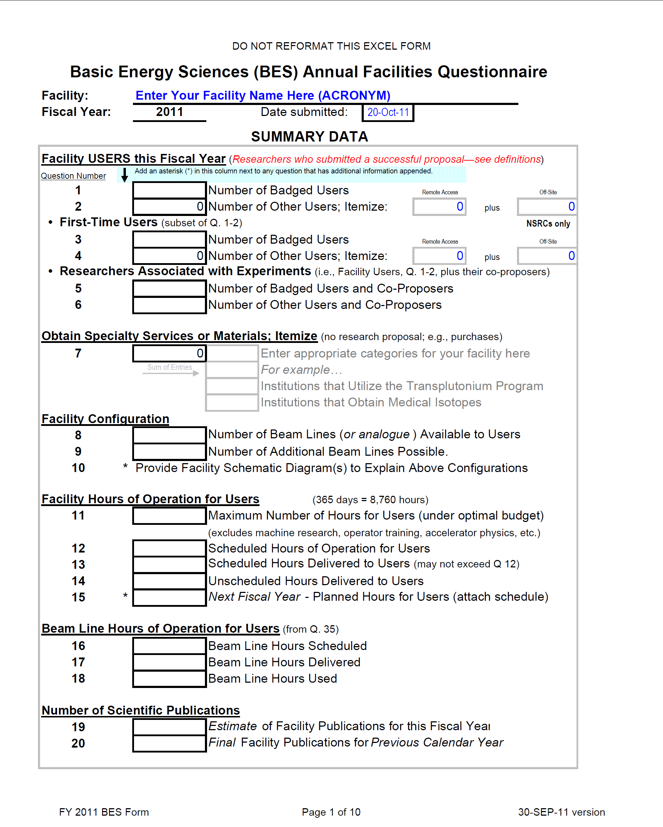
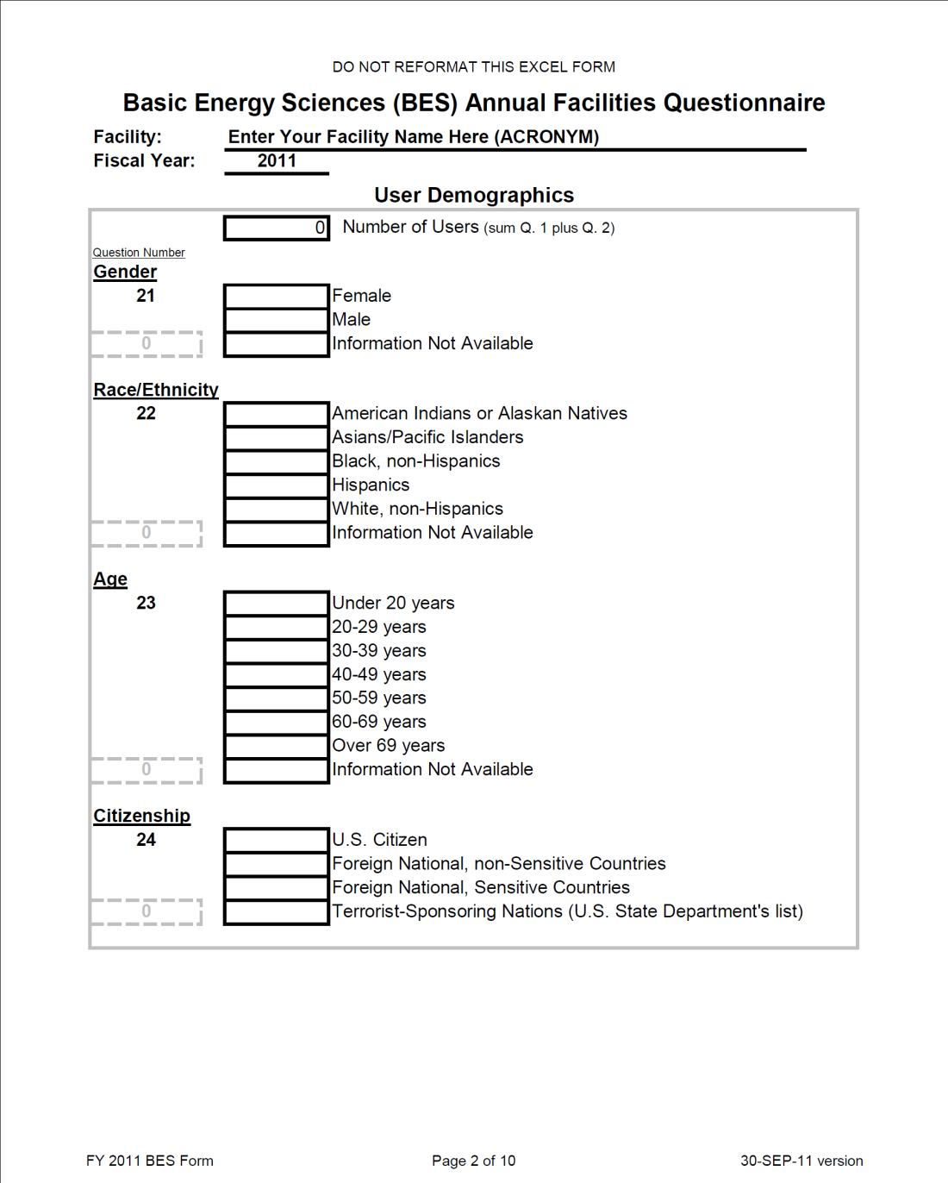

Slide 17
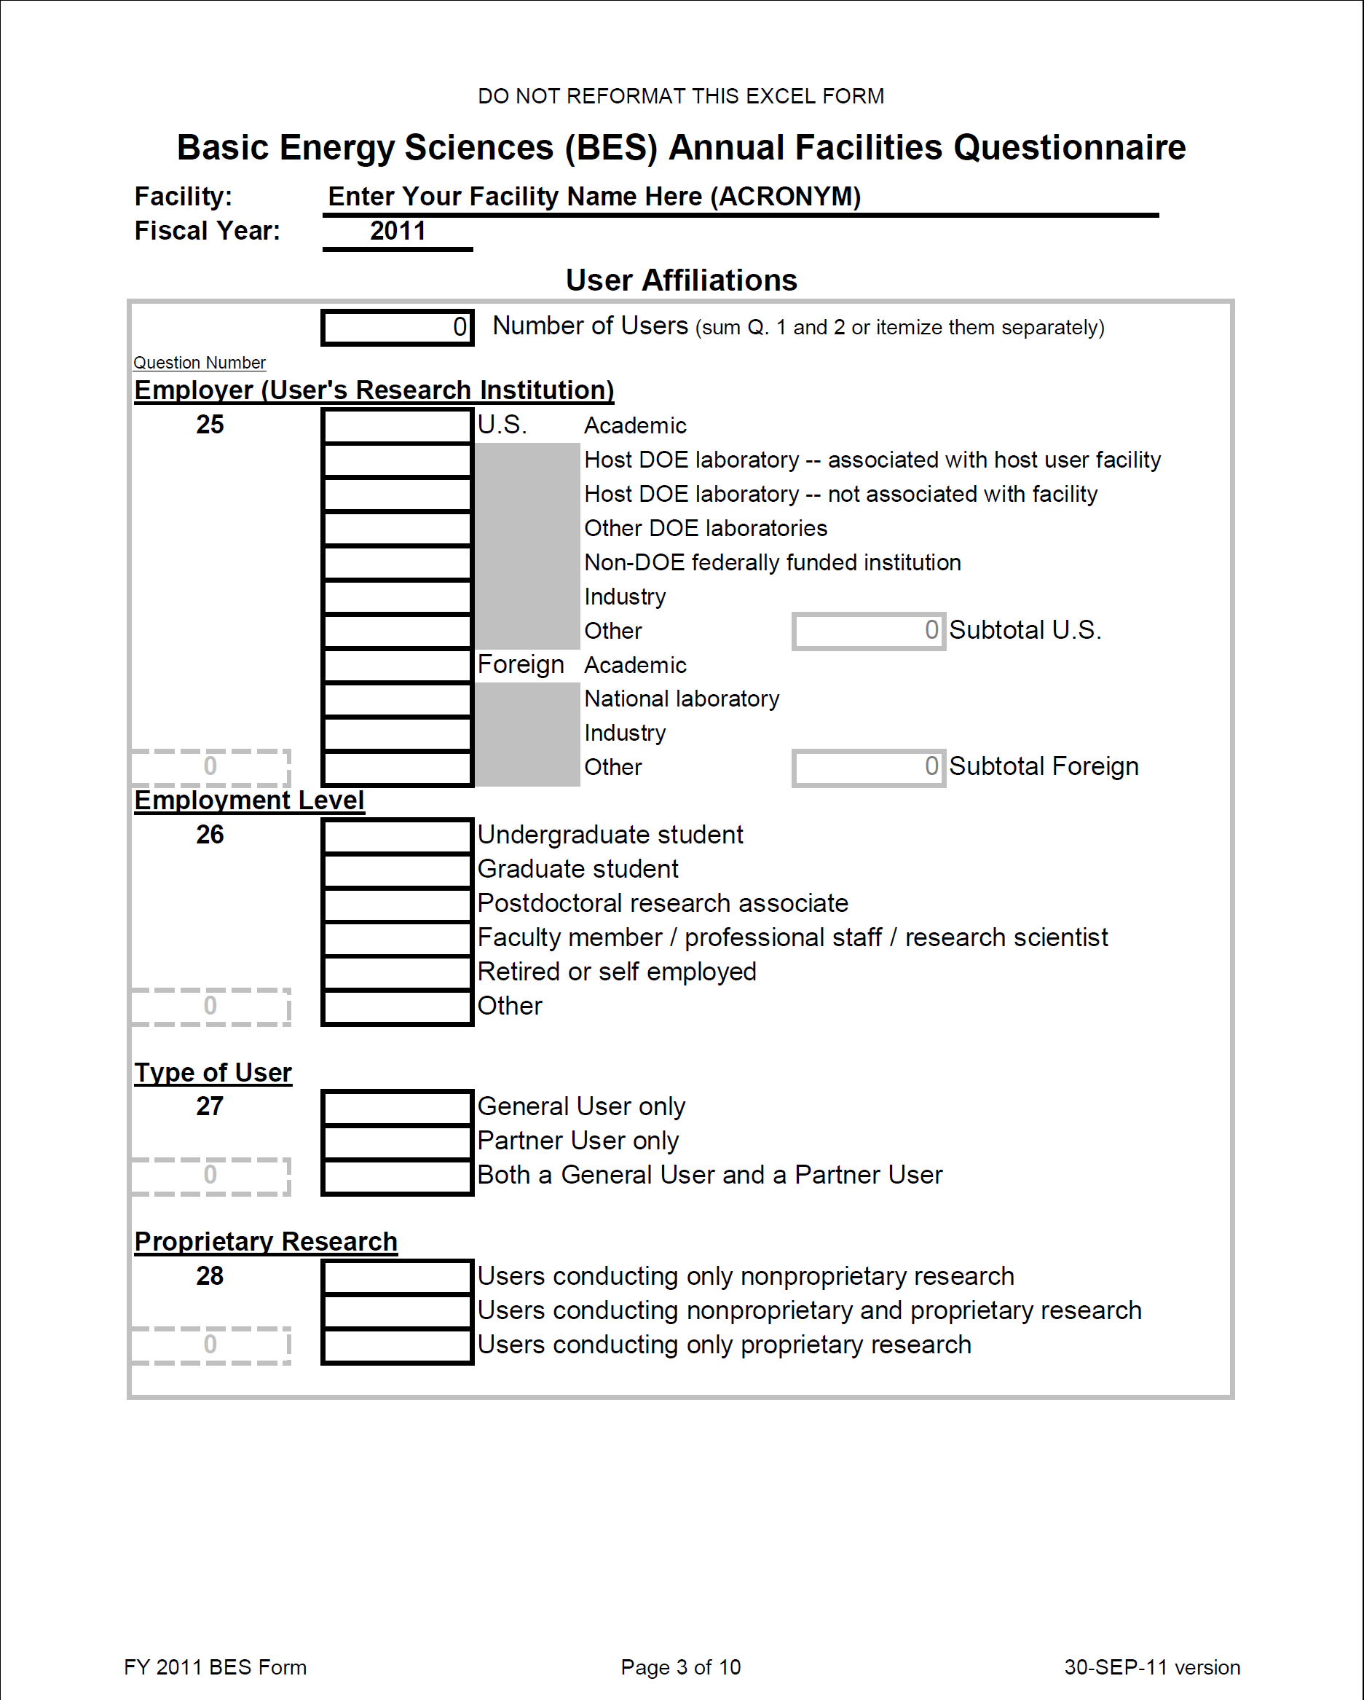
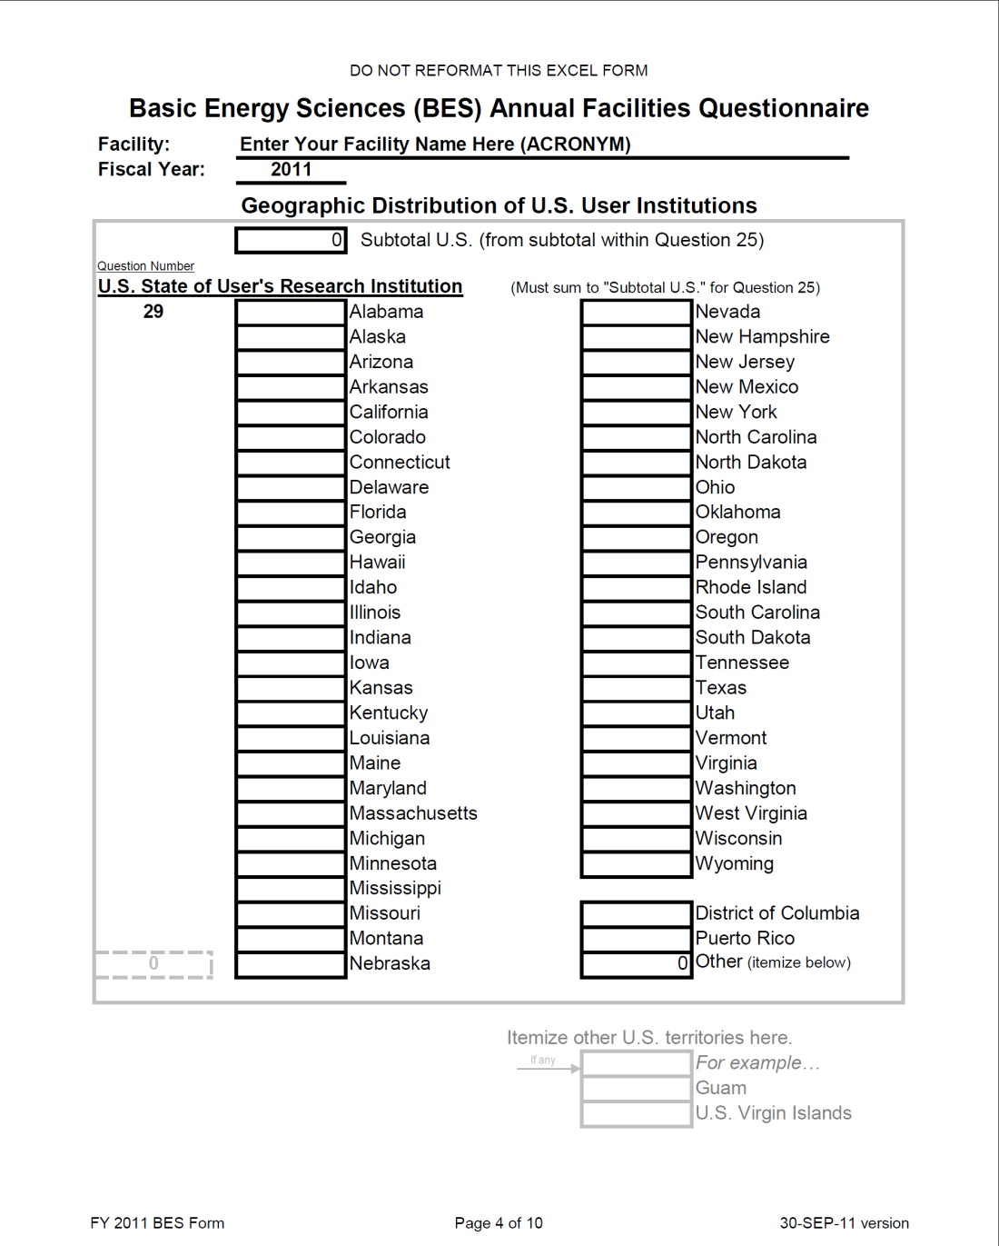

Slide 18
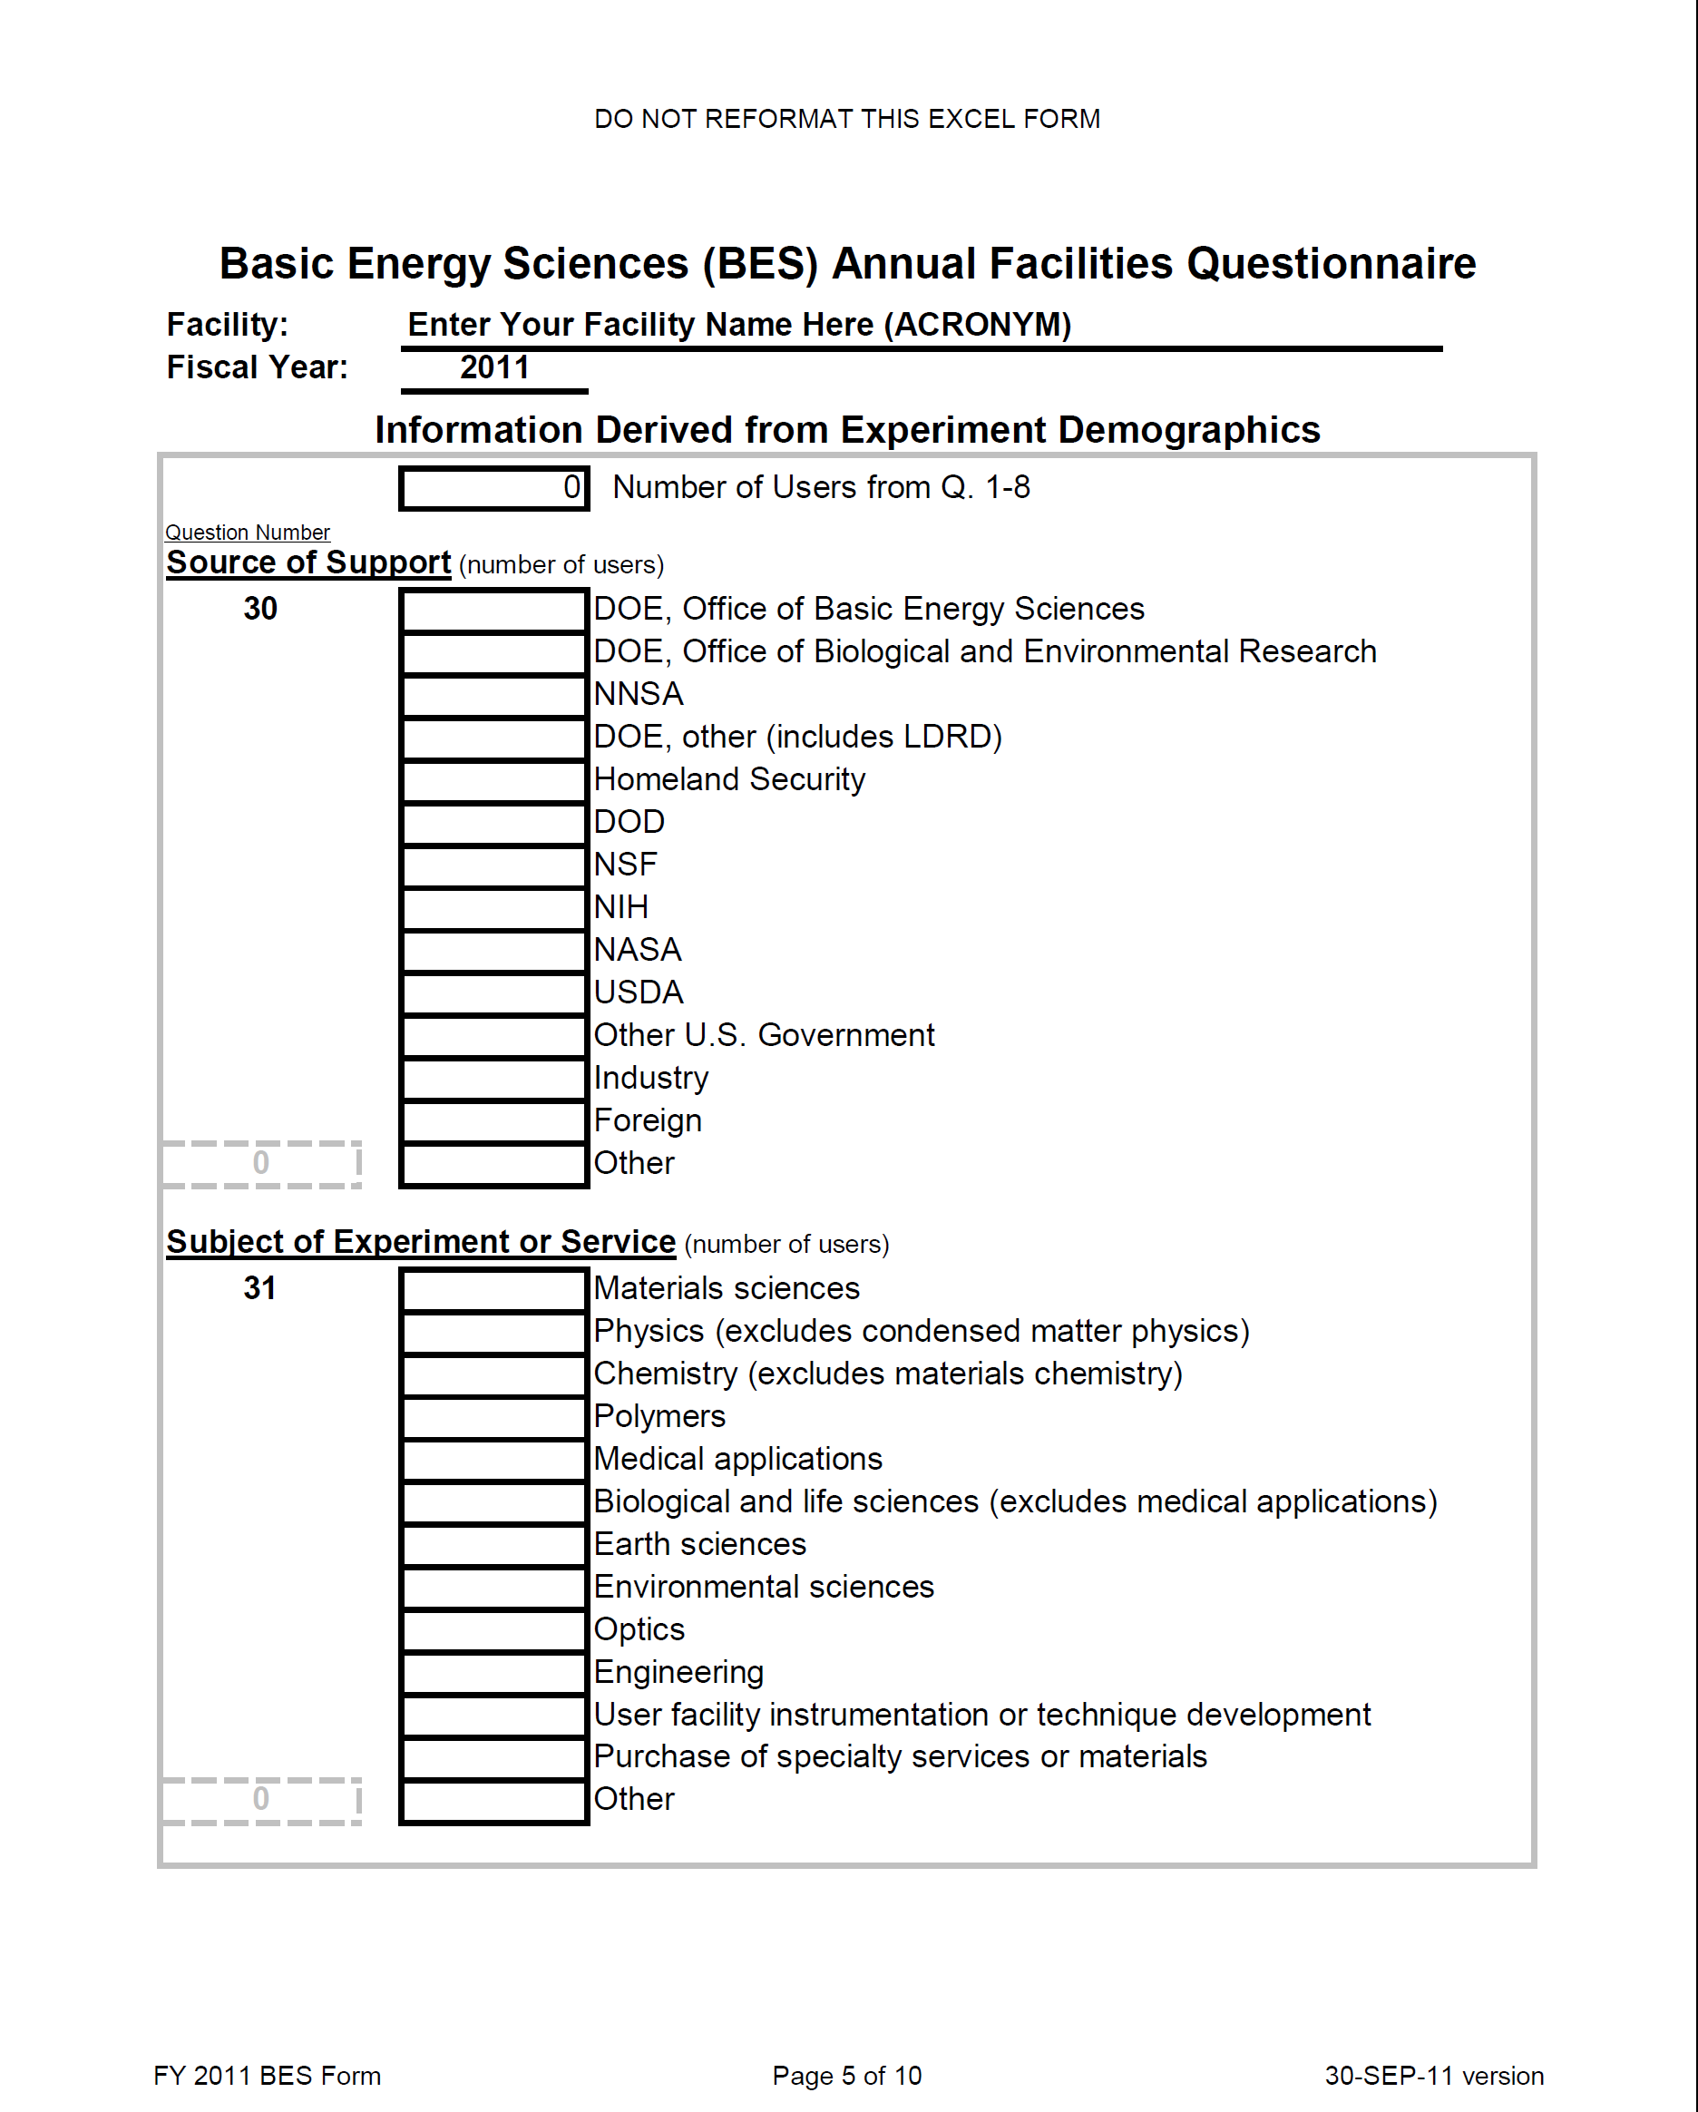
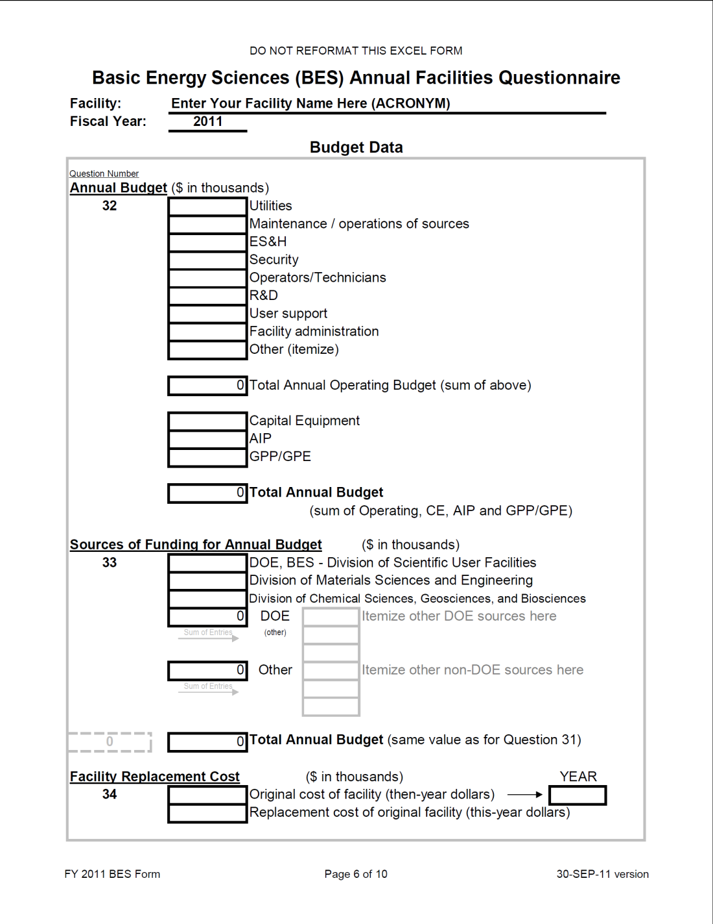

Slide 19
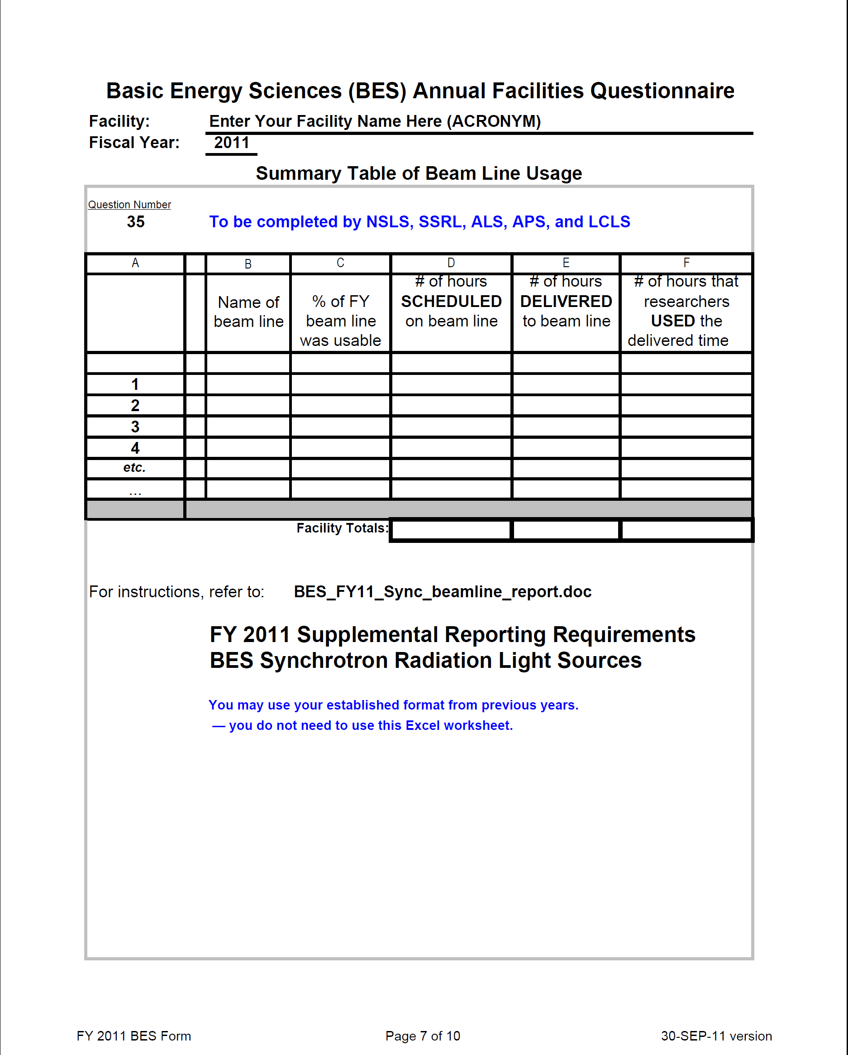
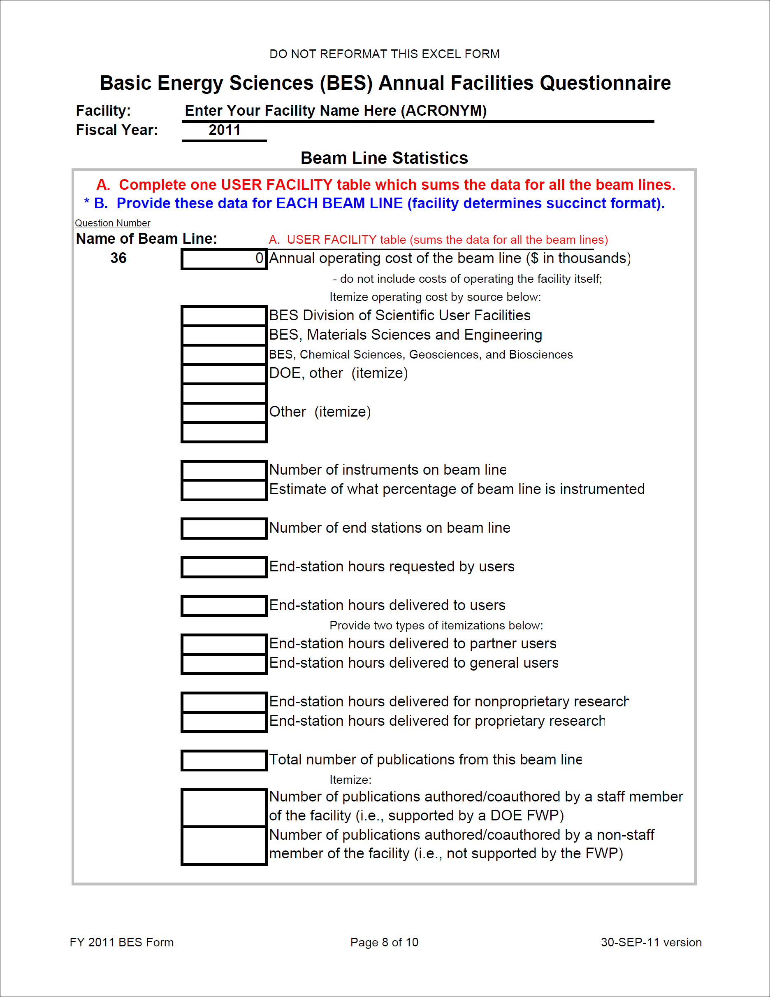

Slide 20
