Slide 1
WDTS Update
July 2012
Patricia M. Dehmer Deputy Director for Science Programs &
Acting Associate Director for WDTS
Office of Science, U.S. Department of Energy
http://science.energy.gov/sc-2/presentations-and-testimony/
Notes:
WDTS dates from FY 2004.
Prior to that time, the core activities (SULI, NSB, and Einstein Fellows) were budgeted in SCPD. Prior to inclusion in SCPD, the workforce activities were in ER except for a small period when DOE apparently attempted to create a new office. But Congress objected in FY 1996. “In fiscal year 1996, these activities are to be managed by the Office of Energy Research as they were from 1977 to 1993.”

Slide 2
Outline
WDTS mission
Recent key events: May 2010 WDTS COV May 2011 AD transition
Program scope
Program budget
Tech dev
Evaluation
Program management @ HQ

Slide 3
WDTS Mission
The WDTS mission is to help ensure that DOE and the Nation have a sustained pipeline of highly skilled and diverse STEM workers. This is accomplished through support of undergraduate internships and visiting faculty programs at the DOE laboratories; a graduate fellowship program, which also involves the DOE laboratories; the Albert Einstein Distinguished Educator Fellowship for K-12 teachers, which is administered by WDTS for DOE and for a number of other federal agencies; and the nation-wide, middle- and high-school science competitions that culminate annually in the National Science Bowl®.

Slide 4
Recent Key Events
Key findings from the May 2010 COV
WDTS contains programs that the COV ranked from excellent to poor with several programs playing a unique and important role in U.S. science workforce development.
Several of the programs that the COV found to be of the highest quality do not have sufficient resources to allow them to reach their full potential.
Periodic short- and long-term assessment of the quality and impact of all programs in WDTS is completely inadequate.
Procedures and policies for establishing new programs are absent.
In nearly all programs in WDTS, there is no connection with scientists, staff, and research activities in DOE Germantown.
Key actions from the May 2011 AD transition
Address COV findings
Align WDTS processes (program management, peer review, budgeting, establishment of new program elements, …) with SOPs used throughout SC.

Slide 5
Current Program Scope
Six core activities:
At the DOE labs, WDTS supports undergrad interns and visiting faculty (64% of FY 2013 budget)
Science Undergraduate Laboratory Internship (SULI)
Community College Internship (CCI)
Visiting Faculty Program
WDTS supports a graduate fellows program and two smaller specialty programs for middle-school and high-school teachers and students (28% of FY 2013 budget)
Albert Einstein Distinguished Educator Fellowship
National Science Bowl
Office of Science Graduate Fellowship (Cohorts started in FY 2010 and FY 2012; no budget request for new cohort in FY 2013)
Business systems modernization, evaluation, and outreach (8% of FY 2013 budget)
A rebuild of on-line application systems will replace decade-old systems, incorporate established SC program management protocols, and collect data for evaluation.

Slide 6
WDTS Programs – FY 2013 ($14.5M)
Outreach
LEDP
Evaluation
TechDev
National Science Bowl
DOE Lab Programs
Einstein
Fellows
VFP
CCI
SULI

Slide 7
DOE Labs Employ >30,000 Scientists and Engineers
Together, the DOE labs employ about 32,000 S&T staff; SC labs employ about 14,000 S&T staff.
Notes:
SC labs employ ~22,000. Maybe ½ are S&T or about 10,000.

Slide 8
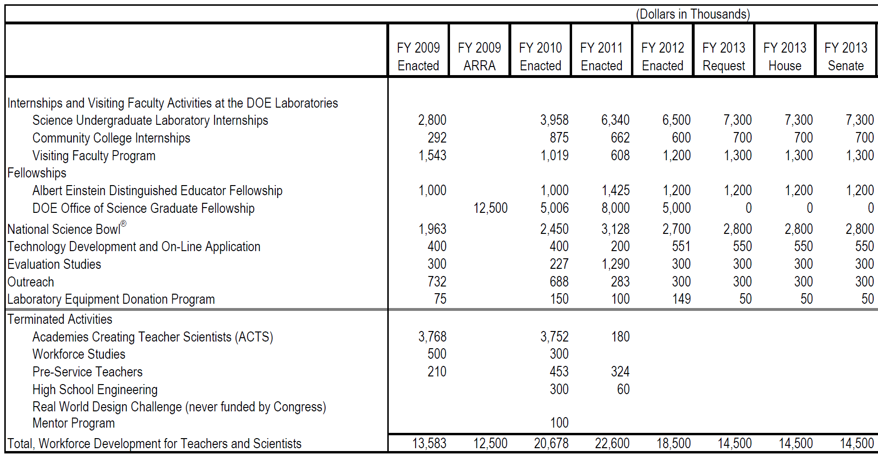
WDTS Budget History
9,105
14,500

Slide 9
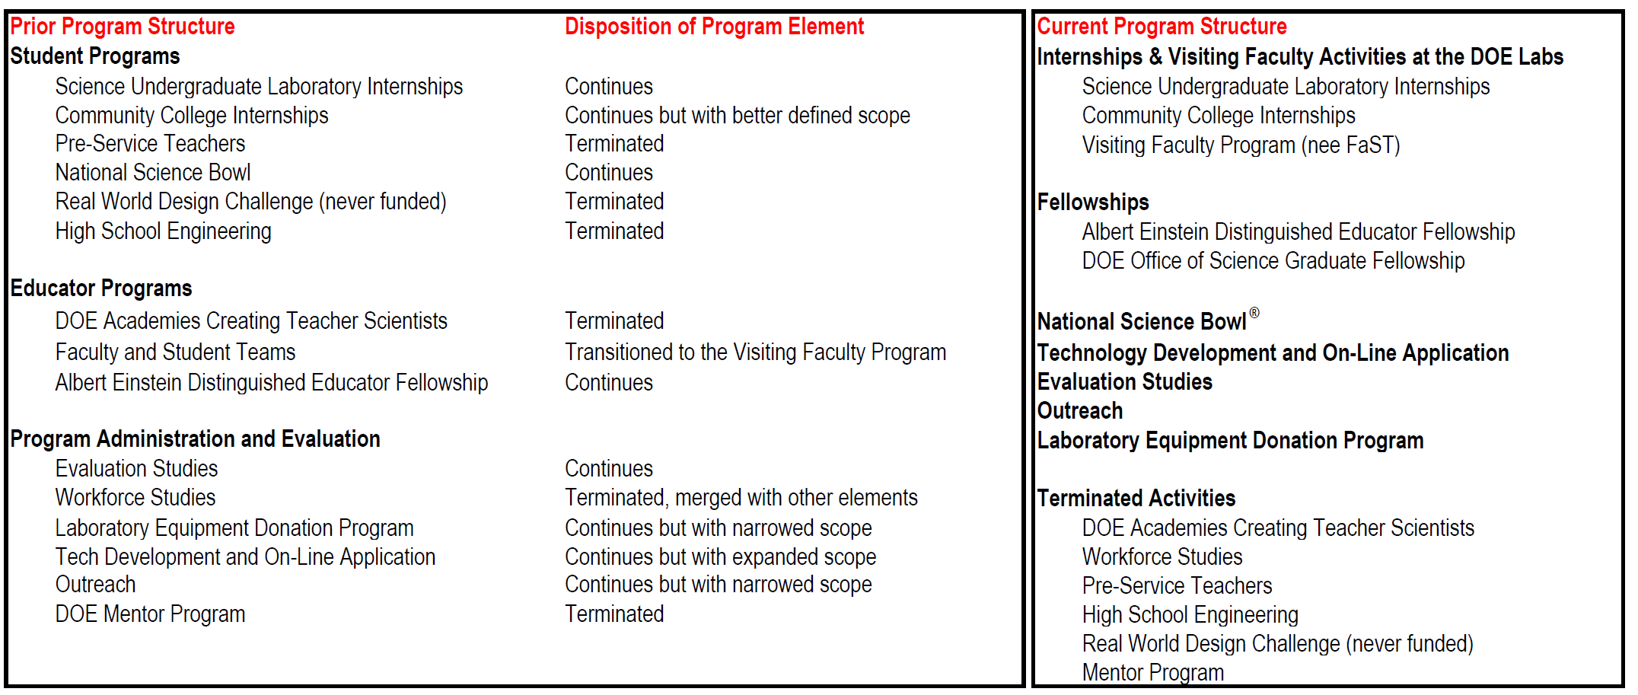
Summary of Evolution of Program Scope Approx FY 2010 - present

Slide 10
SULI, CCI, and VFP
Revised:
Program goal, scope, and definition
Program deliverables
Metrics of success
Measurement and evaluation
Created logic models* for each of the programs; the logic models became the bases for IT requirements documents.
Met with DOE LEDs in July and November 2011 to gather feedback.
The requirements documents are the basis for new software that will incorporate participant applications, reviewer input, participant deliverables, and measurement/assessment questionnaires.
We will collect and archive data so that it can be shared and analyzed.
At today’s meeting, we want to hear from you on the changes that have been made.
* A logic model is one form of the many existing program planning tools; the logic model describes how an activity produces a desired result in terms of four components in a linear sequence: inputs, activities, outputs, and outcomes.

Slide 11
Also from the COV Report re VFP, née FaST
Faculty and Student Teams (FaST):
Rating: Fair
This is a potentially important area to address and to do well in in order to promote institutional change. But…it needs work. To be successful significant groundwork between the lab and the college faculty member is necessary. Additionally instruction in teamwork and research preparation are central to making the program successful. The arrangements for working with the faculty member and the student participants must be sensitive to the needs and responsibilities of both. Evaluation is presently inadequate. The expected follow-up, to position the faculty partner to be successful in research and grant proposal submission, is quite challenging.
B. Recommendations of the COV
The following is a summary of our overall recommendations. More details about many of these recommendations follow this list.
We recommend that WDTS:
Focus its efforts and its resources on its strong programs (SCGF, SULI, CCI, Einstein, Lindau, NSB) and work to improve and expand them to assure future success and impact.
Redirect funds from the weak programs (ACTS, FaST, Undergraduate Research Journal, College Guide, RWDC, PST) to funding the recommended changes and expansions in the strong programs (listed above).

Slide 12
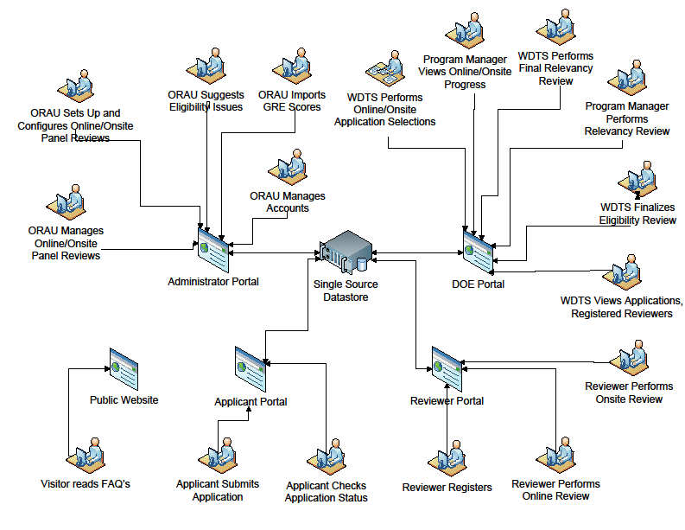
Sample Schematic – Science Undergraduate Laboratory Internship
WDTS Queries of
Historical Data
WDTS Oversight of Placement Processes
ORAU Suggests Compliance issues
WDTS PMs monitor participant and Lab deliverables
ORAU Directs applications to first and second choice DOE Labs
WDTS Approves Eligibility Review
WDTS Approves Compliance Review
ORAU…
Participant Interface
WDTS views applications and application status
Participant and Deliverables Portal
Scientist/Mentor
Interface
NSF interface with NSF funded applicants
DOE Lab Ed Portal
DOE Lab Ed Office Interface
DOE Lab Ed Office Placement Review and Sorting
DOE Lab Research Advisor Selects Applicants
Recommender submits letter
12
DOE website

Slide 13
Budgets
FY 2011
Significant carryover funds
All carryover funds tightly managed, and those funds at ORISE reserved to enable the new SCGF cohort (50 students, fully funded for 3 years)
FY 2012 and beyond
WDTS will distribute the majority of its laboratory funds in the Initial Fin Plan with detailed guidance.
FWPs tie closely to funding
Regular reviews of labs
Notes:
SC labs employ ~22,000. Maybe ½ are S&T or about 10,000.

Slide 14
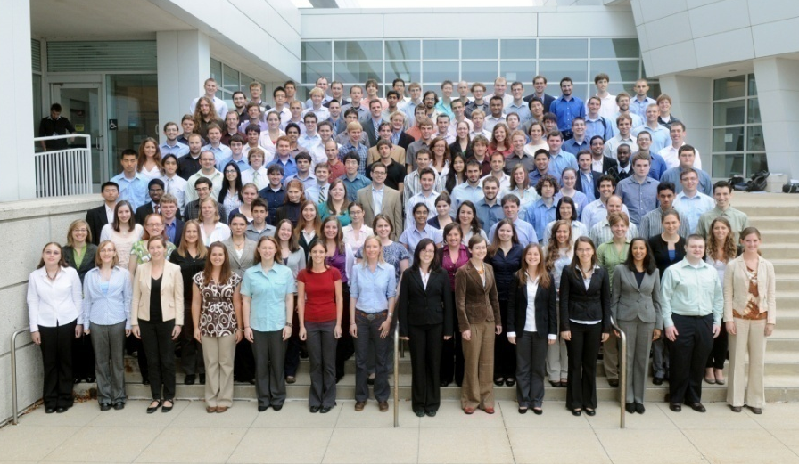
SC Graduate Fellowship Program
Begun in 2009 with ARRA funding and WDTS base funding, the SCGF program provides 3-year fellowship awards totaling $50,500 annually, to graduate students pursuing advanced degrees.
The awards provide support towards tuition, a stipend for living expenses, and support for research expenses such as travel to conferences and to DOE user facilities.
Fellows participate in an annual research meeting with SC-supported scientists and learn how to access SC scientific user facilities; SC research program managers are encouraged to include Fellows in programs’ meetings.
150 Fellowships awarded in FY 2010.
50 Fellowships awarded in FY 2012.
DOE SCGF Cohort 2010 at the SCGF Annual Meeting at Argonne National Laboratory.

Slide 15
Evaluation WDTS program evaluation is undergoing revision
WDTS will use Office of Science standard peer review practices:
Contractor program management: External peer review, including site and reverse-site visits, of laboratory education program offices and other performers [ORISE and Triangle Coalition] provide assessments of contractor program management.
Federal program management: COV reviews provide assessments of federal program management and the status of the WDTS programs relative to comparable programs supported by other agencies.
Program impact: Application information, participant surveys, participant deliverables, and alumni surveys provide input on the impact of the program on the participants.
Derived from the logic models, each activity has a set of measureable outputs and outcomes.
Notes:
Established as an official U.S. Department of Energy (DOE) institute in 1992, with programs dating back to 1946, the Oak Ridge Institute for Science and Education (ORISE) is a national leader in science education and research.

Slide 16
Outputs vs. What we measure
Outputs (SULI) High Level Chart
(Direct products of program activities)
High quality of undergraduate research experience.
Undergraduates produce research deliverables: a written report, and an oral or poster presentation.
All completed applications receive fair consideration through an open and transparent review process.
Attraction of a high quality applicant pool.
High quality science or technical advisor experience.
Attraction of quality research advisors spanning a variety of scientific and engineering disciplines consistent with the SC/DOE R&D programs.
High quality of federal program management.
High quality of laboratory program execution.
Outputs (SULI) Measured Annually*
Program management related:
# of proposals/ applications received annually.
# & % of applications that meet or exceed program requirements.
# of awards or participants selected.
COV reviews of federal program management (~triennial).
External lab program peer reviews (~triennial).
Demographic data for internal purposes.
Program quality and student experience related:
% of student who complete the program.
% of students that report a high quality experience.
% of student who report increased [content knowledge/skills/preparedness for STEM career, etc] as a result of the program.
Materials produced from the internships by participants (publications; patents; invited and contributed presentations).
% of participants completing a research report and oral/poster presentation.
% of students whose final deliverables meet or exceed program requirements (review process TBD).
% of student who report a better understanding of the DOE and Office of Science mission needs and programs.
% of students making impact/contribution to the research project.
% of students working on a SC/DOE relevant projects.
% of students working on a SC funded project; a DOE funded project.
% of students who receive feedback from their advisor on their deliverables.

Slide 17
Measurement sources or “vehicles”
Outputs (SULI) Measurement
Program management related:
# of proposals/ applications received annually.
# & % of applications that meet or exceed program requirements.
# of awards or participants selected.
COV reviews of federal program management (~triennial).
External lab program peer reviews (~triennial).
Demographic data for internal purposes.
Program quality and student experience related:
% of student who complete the program.
% of students that report a high quality experience.
% of student who report increased [content knowledge/skills/preparedness for STEM career, etc] as a result of the program.
Materials produced from the internships by participants (publications; patents; invited and contributed presentations).
% of participants completing a research report and oral/poster presentation.
% of students whose final deliverables meet or exceed program requirements (review process TBD).
% of student who report a better understanding of the DOE and Office of Science mission needs and programs.
% of students making impact/contribution to the research project.
% of students working on a SC/DOE relevant projects.
% of students working on a SC funded project; a DOE funded project.
% of students who receive feedback from their advisor on their deliverables.
Actual or Potential “Vehicle”
Application and review process documentation
Biannual or triennial external review of labs; triennial COVs. (look at multiple program outputs and summative data)
Direct measurement, accounted for in deliverables systems
Pre- and post- survey of students

Slide 18
Near-term Outcomes vs. What we measure
Near-term Outcomes (SULI)
High Level Chart
(Direct benefits, near-term, as a result of the program)
Undergraduates acquire research skills.
Undergraduates improve their cognizance of SC/DOE mission and STEM career opportunities.
Undergraduates’ experiences positively influence their decisions to complete an undergraduate degree in a STEM subject/field.
Undergraduates’ experiences positively influence their decisions to pursue a graduate degree in a STEM subject/field.
Undergraduates are influenced to continue training and/or participation in STEM research.
SC/WDTS provide best in class federal program management.
Laboratories provide best-in-class research internships.
Near-term Outcomes (SULI)
Measured
(Recent past participation data collection, cumulative data)
% of participants who report the experience as significantly valuable to their professional development and future career goals.
% of students who participate in a follow-on research experience.
% of participants who continue with a STEM related job or education after the internship (complete undergraduate and/or graduate degrees or certifications in STEM).
% of participants who apply to jobs at DOE Laboratories (normalized for availability of opportunities).
% of participants who continue to engage in collaborative research activities with DOE-supported investigators.
Positive COV review of federal program management (in FY13/14 and ~triennially thereafter).
Positive Lab program peer reviews (~triennial).

Slide 19
Measurement sources or “vehicles”
Near-term Outcomes (SULI) Measured
(Recent past participation data collection, cumulative data)
% of participants who report the experience as significantly valuable to their professional development and future career goals.
% of students who participate in a follow-on research experience.
% of participants who continue with a STEM related job or education after the internship (complete undergraduate and/or graduate degrees or certifications in STEM).
% of participants who apply to jobs at DOE Laboratories (normalized for availability of opportunities).
% of participants who continue to engage in collaborative research activities with DOE-supported investigators.
Positive COV review of federal program management (in FY13/14 and ~triennially thereafter).
Positive Lab program peer reviews (~triennial).
Actual or Potential “Vehicle”
Post-participant surveys
Alumni surveys
Laboratory reporting
External peer review of laboratories; triennial COVs.

Slide 20
Long-term Outcomes vs. What we measure
Long-term Outcomes and Impacts (SULI)
High Level Chart
Undergraduates’ experiences positively influence their decisions to complete a graduate degree in a STEM subject/field.
Undergraduates’ experiences positively influence their decisions to pursue a STEM career.
Undergraduates pursue careers working on or with SC/DOE supported programs or projects.
Awareness of DOE-related STEM career opportunities among undergraduate students, STEM faculty, and career counseling staff is increased.
Laboratories have developed a reputation for executing best in class research internships.
SC/WDTS has developed a reputation for managing best-in-class undergraduate internship programs.
The pool of highly qualified scientists and engineers to support the SC/DOE mission increases.
Long-term Outcomes and Impacts (SULI)
Cumulative Measurement
# of participants who become employed at a DOE lab increases.
# of participants who pursue careers working on SC or DOE funded project at a non-DOE lab institution increases.
% of participants who remained in STEM careers or academia after 2/5/10 years increases.
The pool of highly qualified applicants applying to DOE/SC and DOE lab jobs increases.
Consistently excellent COV reviews of federal program management.
Consistently excellent laboratory program peer reviews at each of the participating DOE laboratories.
Program opportunities influence new students to pursue STEM fields of study.

Slide 21
Measurement sources or “vehicles”
Long-term Outcomes and Impacts (SULI)
Cumulative Measurement
# of participants who become employed at a DOE lab increases.
# of participants who pursue careers working on SC or DOE funded project at a non-DOE lab institution increases.
% of participants who remained in STEM careers or academia after 2/5/10 years increases.
The pool of highly qualified applicants applying to DOE/SC and DOE lab jobs increases.
Consistently excellent COV reviews of federal program management.
Consistently excellent laboratory program peer reviews at each of the participating DOE laboratories.
Program opportunities influence new students to pursue STEM fields of study.
Actual or Potential “Vehicles”
Relies heavily on alumni surveys and sustained contact with participants.
Could more uniformly capture lab hires through lab HR processes.
Will require some tracking and surveying of comparison groups to address relative impact (e.g. those who declined offers).
Updated and future systems that better document people may help:
SC is currently does not rigorously collecting information on undergraduates or graduate students funded on research awards; we could do this in the future.
SciENCV may help in the future.

Slide 22
Status of Evaluation Activities
Developed draft logic models for SULI, CCI, and VFP; vetted with LEDs.
Developed Initial logic model for SCGF with ORISE.
******************************************
Complete logic models for SULI, CCI, VFP, NSB, AEF, and SCGF
Establish measures and “vehicles”
Develop spreadsheets that tie outputs/outcomes to measured variables and vehicles
Revise pre- and post-participant surveys. Use external review to rule out bias.
Establish plan to obtain data annually.
Establish longer-range plan for alumni surveys and management of social media to keep track of past participants for future surveys.
Develop sets of standard reports that the labs routinely receive.
Prepare internal records and establish appropriate archive of records for next COV.
External peer reviews of the laboratories this year.
Much longer term: Periodic studies using “control” populations to evaluate program impact.

