Slide 1
Synchrotron Radiation Light Sources
Briefing for SEAB
20 June 2014
Patricia M. Dehmer
Acting Director, Office of Science
U.S. Department of Energy

Slide 2
Synchrotron Radiation Light Sources
  What, why, how, where?
Office of Science light sources
  Storage rings
  Free electron lasers
What’s next for U.S. light sources?
(This is a 100% equation-free presentation.)

Slide 3
What is Synchrotron Radiation?

Slide 4
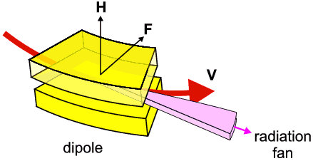
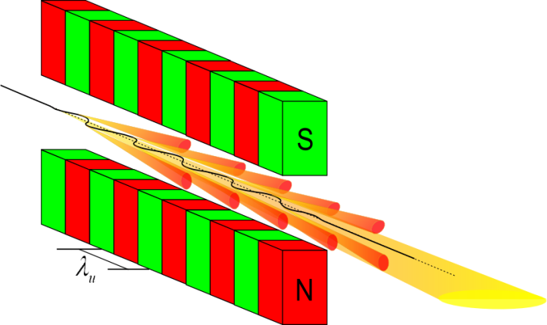
What is Synchrotron Radiation?
Synchrotron radiation is electromagnetic radiation emitted when charged particles—in this case, electrons—are accelerated radially using magnetic fields.
Specially designed magnets or
arrangements of magnets produce
radiation with specific, desired
properties.
Magnet configurations include
simple bending magnets or arrays
of magnets called undulators and
wigglers.

Slide 5
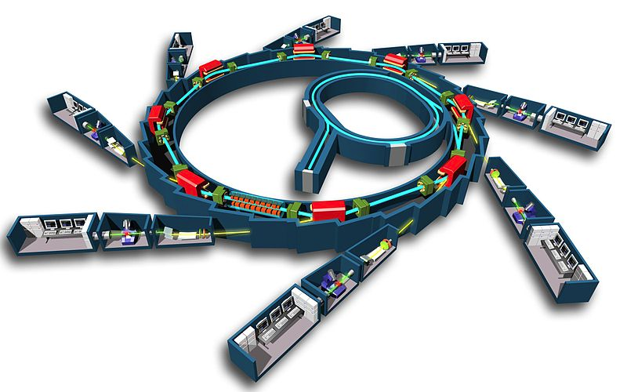
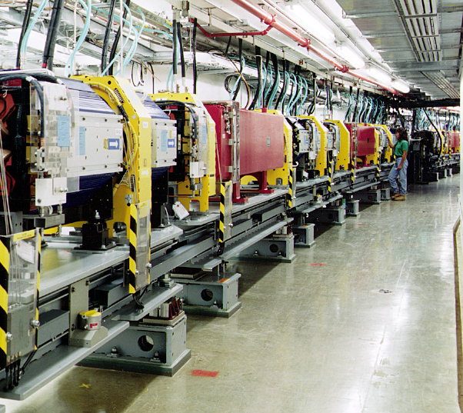
Radiation from Bending Magnets
Electron
Storage
Ring
Booster
Synchrotron
7 GeV
Linac
450MeV
Insertion
Device
Beamlines & Instruments
(40 straights:
5 for injection & acceleration;
35 “sectors” for instruments

Slide 6
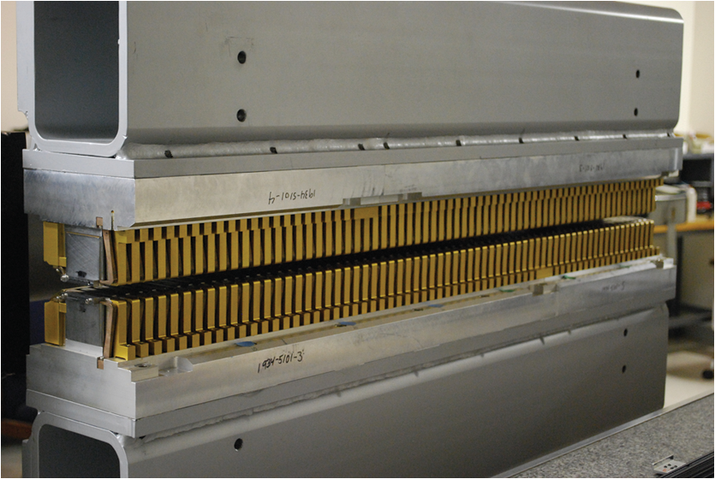
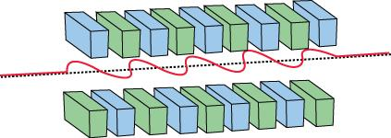
Radiation from Insertion Devices
Wigglers and Undulators

Slide 7
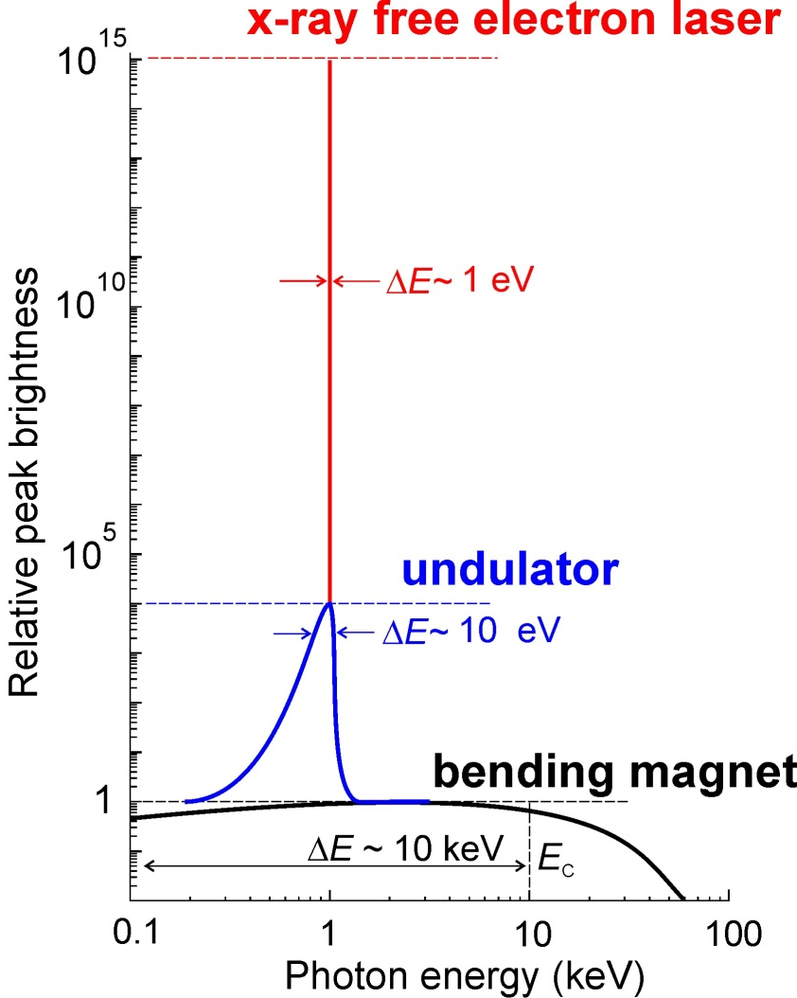
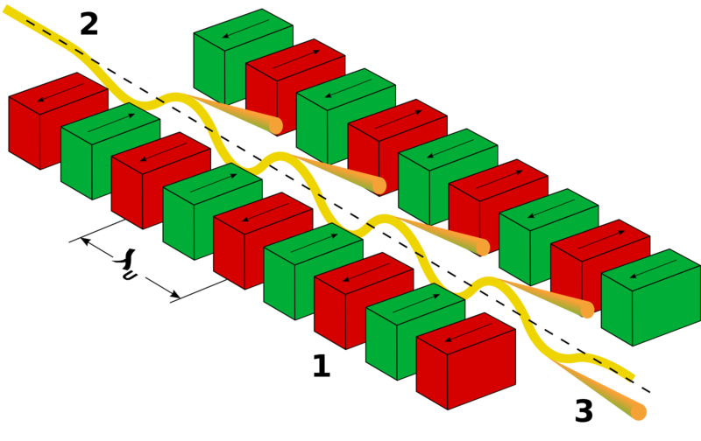
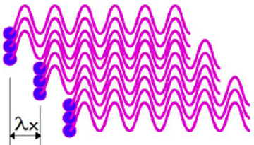
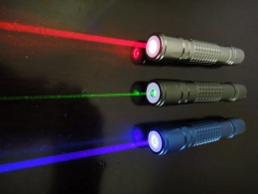
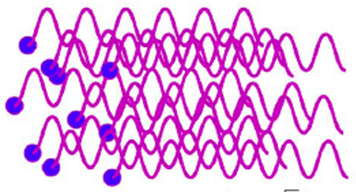
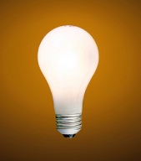
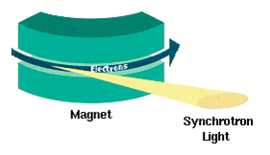
Jim,
Jim --
X-FELs:Coherent Radiation
Periodic B-Field
Undulators
SLAC FEL: 100 meters long
Storage ring: few meters long
Rings: Spontaneous Radiation
Bending Magnets
Uniform
B-Field
storage ring
e⁻

Slide 8
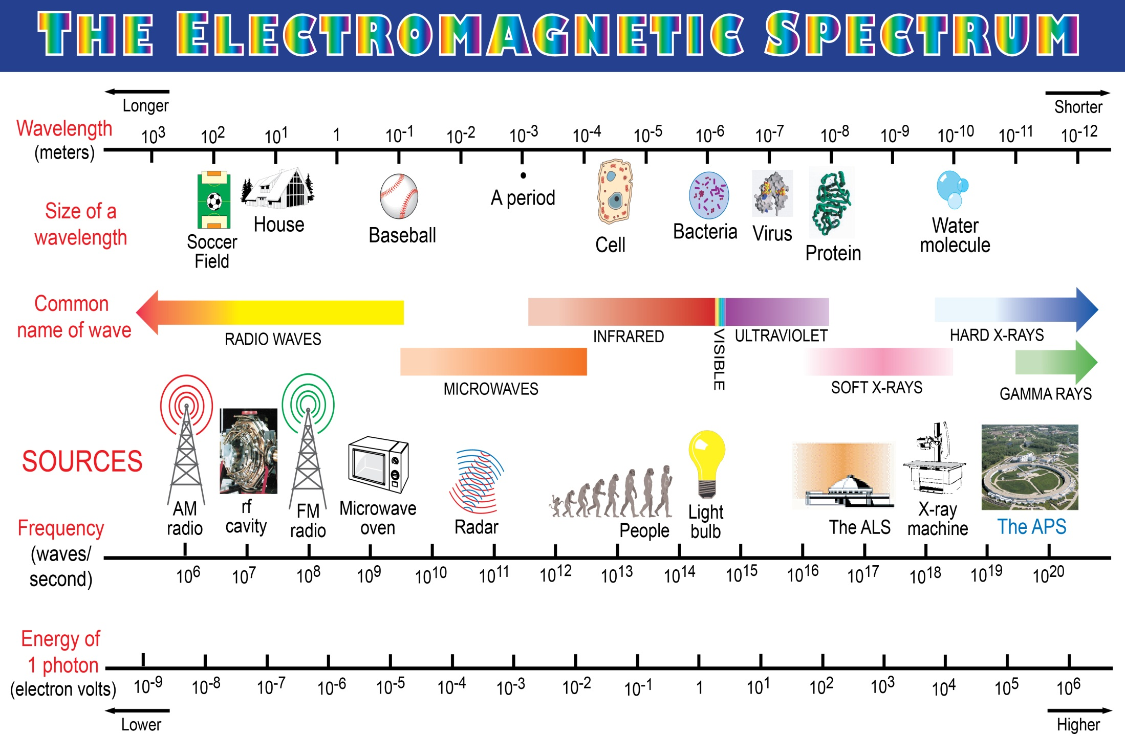
Synchrotrons

Slide 9
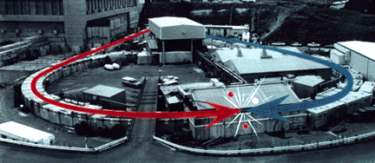
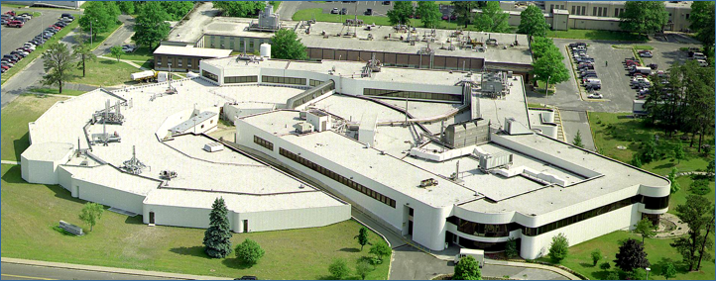
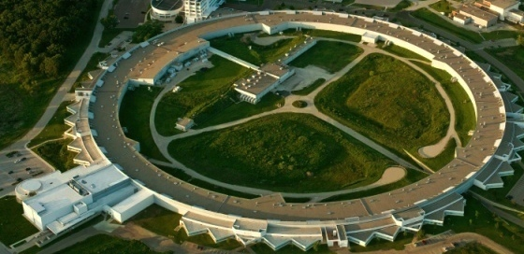
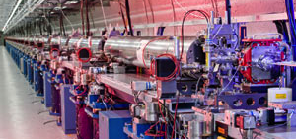
Synchrotron Light Sources Evolution by Generation
First observation of manmade synchrotron radiation @ General Electric in 1947
1st Generation: parasitic synchrotron radiation source from the dipoles of an HEP collider storage ring (SPEAR, 1975)
2nd Generation: dedicated storage ring for synchrotron radiation, dipole radiation & some undulators (NSLS, 1982)
3rd Generation: dedicated storage ring optimized for undulator radiation; very high brightness (ALS, 1993; APS, 1996;
SSRL, 2004; NSLS-II, 2014)
4th Generation: dedicated linac driven free electron laser (LCLS, 2009 )

Slide 10
The History of SC/BES Light Sources
LCLS-II
2019
ALS-U TBD
NSLS-II 2014
LCLS
2010
APS-U 2020s
SSRL 2004
ALS 1993
No longer operational
Operational
Under Construction
In Design
SSRP
1974
NSLS 1982
APS 1996

Slide 11
What are X-rays Used for?

Slide 12
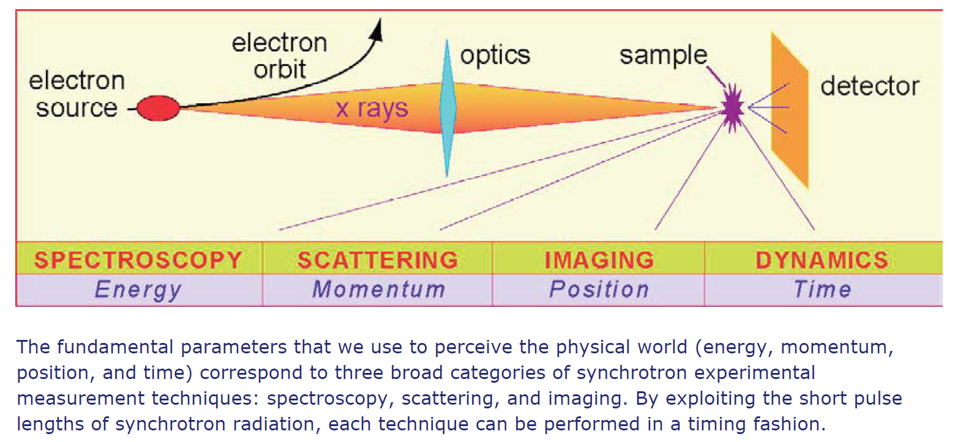
Experimental Techniques

Slide 13
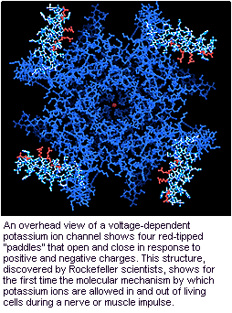
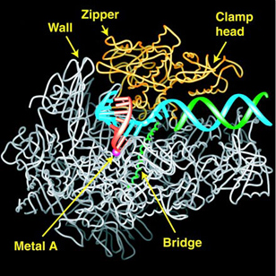
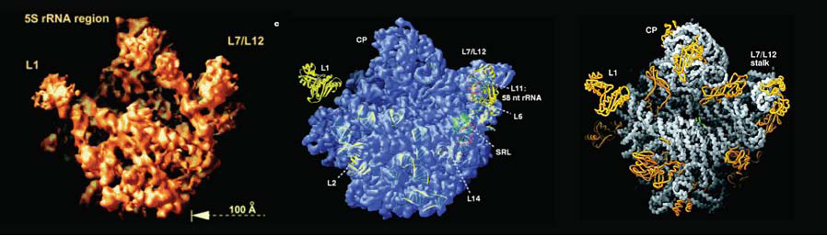
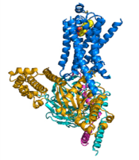
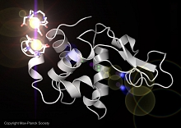
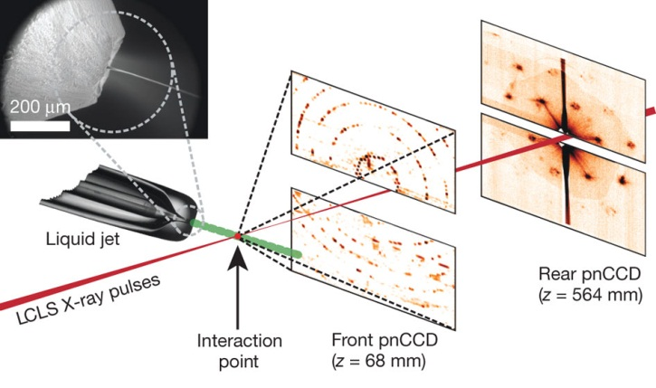
4 Nobel Prizes in Biochemistry with SC Storage Ring Light Sources
& the Prospect of Single-Molecule, Single-Shot Imaging with FELs
 | Roderick MacKinnon (Chemistry) for “structural and mechanistic studies of ion channels.”
 | Roger Kornberg (Chemistry) "for his studies of the molecular basis of eukaryotic transcription.”
 | Venkatraman Ramakrishnan, Thomas A. Steitz, and Ada E. Yonath (Chemistry) "for studies of the structure and function of the ribosome.”
 | Robert J. Lefkowitz and Brian K. Kobilka (Chemistry) "for studies of G-protein-coupled receptors.”
The overall view of a voltage-dependent potassium ion channel.
2003
The visualized transcription process.
2006
Nobel Prizes with SC storage rings in protein structures
2009
The structure of the β2AR-Gs complex.
2012
The 50S subunit at 2.4Å resolution.
HN Chapman et al. Nature 470, 73-77 (2011)
Early experiments in single-molecule, single-shot imaging at LCLS
The structure of the β2AR-Gs complex.
Single Shot Diffraction Pattern
Reconstructed Image
The Experiment
FY14: First de novo 3D
structure of lysozyme

Slide 14
What Do We Care Most About in Light Sources?
Some key properties of the x-rays are inherited from the electrons
Wavelength Range
    Determines science reach—atomic or electronic structure and dynamics
Brightness: Average and Peak
    Determines measurement sensitivity
Pulse Width
    fs pulses opens the window on ultrafast dynamics and ‘probe before destroy’ technology
Coherence
    Allows new techniques (e.g. coherent imaging)
    Leads to high brilliance of the beams (transform limited pulses)
Stability
    Source stability in energy, position, time, intensity
Number of Undulators/Beamlines/Endstations
    Determines the number of users in parallel that can be accommodated and ultimately how much science gets delivered

Slide 15
Who Uses Light Sources?

Slide 16
Users by Discipline at the Light Sources
Number of Users

Slide 17
Users by Employer at the Light Sources

Slide 18
Other Demographics of Users at Light Sources
33% | First-Time Users
27% | Female
 | Citizenship
50% | United States
29% | Foreign, Non-Sensitive Countries
21% | Foreign, Sensitive Countries
 | Nature of Research
98% | Nonproprietary research only
1% | Nonproprietary & proprietary research
1% | Proprietary research only

Slide 19
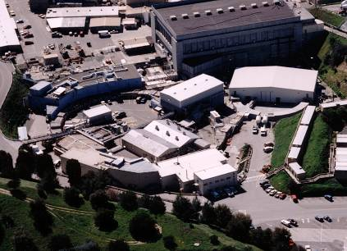
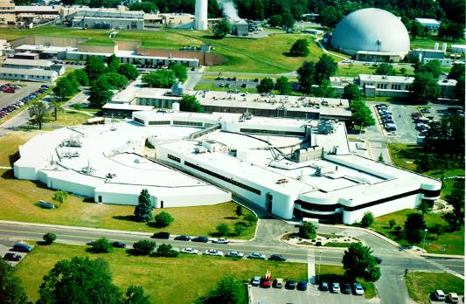
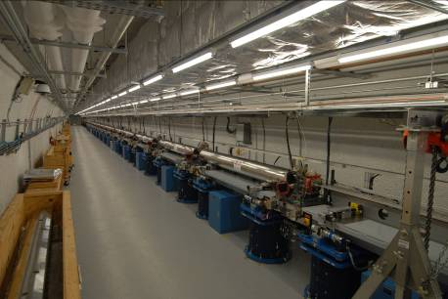
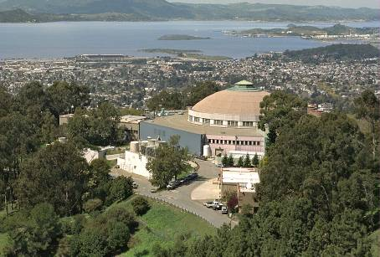
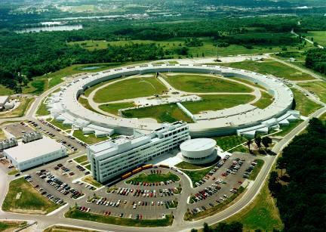
Users by Facility at the Light Sources
SSRL 1974 & 2004
NSLS 1982
LCLS 2009
ALS 1993
APS 1996

Slide 20
Strategic Plans: Past and Present

Slide 21
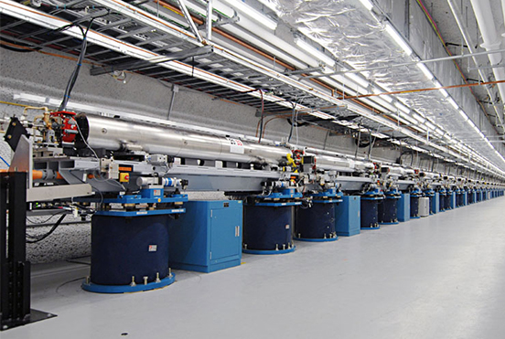
Plans: Past
BESAC Report: Novel Coherent Light Sources, January 1999
Given currently available knowledge and limited funding resources, the hard X-ray region (8-20 keV or higher) is identified as the most exciting potential area for innovative science. DOE should pursue the development of coherent light source technology in the hard X-ray region as a priority. This technology will most likely take the form of a linac-based free electron laser device using self-amplified stimulated emission or some form of seeded stimulated emission. The developers of such a source should seek to attain both temporal and spatial coherence, as well as precise timing with ultrashort pulsed lasers, which will be required for laser pump/X-ray probe experiments.
LCLS Commissioned, April 2009

Slide 22
Plans: Present—Charge to BESAC on X-ray Light Sources
On January 2, 2013, Bill Brinkman issued a charge to the Basic Energy Sciences Advisory Committee (BESAC).
The charge requested:
  assessment of the grand science challenges
  evaluation of the effectiveness of the present light source portfolio
  enumeration of future light source performance specifications
  prioritized recommendations on future light source concepts
  prioritized research and development initiatives
John Hemminger, the Chair of BESAC, served as Chair of a 22 member Subcommittee, which used previous BESAC and BES reports and new input from the x-ray sciences communities to formulate findings and recommendations.
  The final report was accepted by BESAC on July 25, 2013.

Slide 23
Findings and Recommendations
At the present time, the U.S. enjoys a significant leadership role in the x-ray light source community. This is a direct result of the successes of the major facilities managed by BES … and the particularly stunning success of the first hard x-ray free electron laser, the Linac Coherent Light Source (LCLS).
However, it is abundantly clear that international activity in the construction of new diffraction limited storage rings and new free electron laser facilities will seriously challenge U.S. leadership in the decades to come.
The U.S. will no longer hold a leadership role in such facilities unless new unique facilities are developed …

Slide 24
Storage Rings

Slide 25
Findings and Recommendations – Storage Rings
… BES should ensure that U.S. storage ring x-ray sources reclaim their world leadership position. This will require a careful evaluation of present upgrade plans to determine paths forward that will guarantee that U.S. facilities remain at the cutting edge of x-ray storage ring science. The very large, diverse U.S. user population presently utilizing U.S. storage rings represents a major national resource for science and technology. It is essential that the facilities this science community relies on remain internationally competitive in the face of the innovative developments of storage rings in other countries. Such developments include diffraction-limited storage rings with beamlines, optics, and detectors compatible with the 10²-10³ increase in brightness afforded by upgraded storage rings.

Slide 26
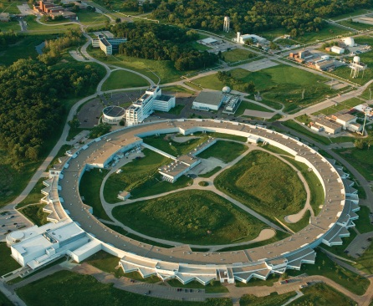
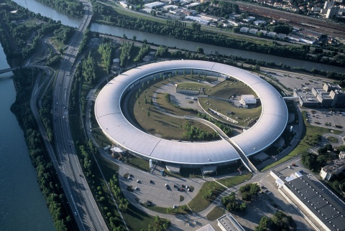
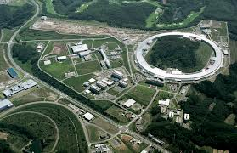
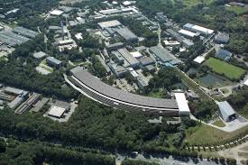
High Energy, Hard X-ray Ring Upgrade Plans
APS, ESRF & SPring-8 are all designing upgrades to incorporate multi-bend achromat lattices to reduce the emittance towards the diffraction limit to enhance brightness.
Double Bend Achromat
Seven Bend Achromat
APS 7 GeV
ESRF 6 GeV
Spring-8 8 GeV
PETRA-III 6 GeV

Slide 27
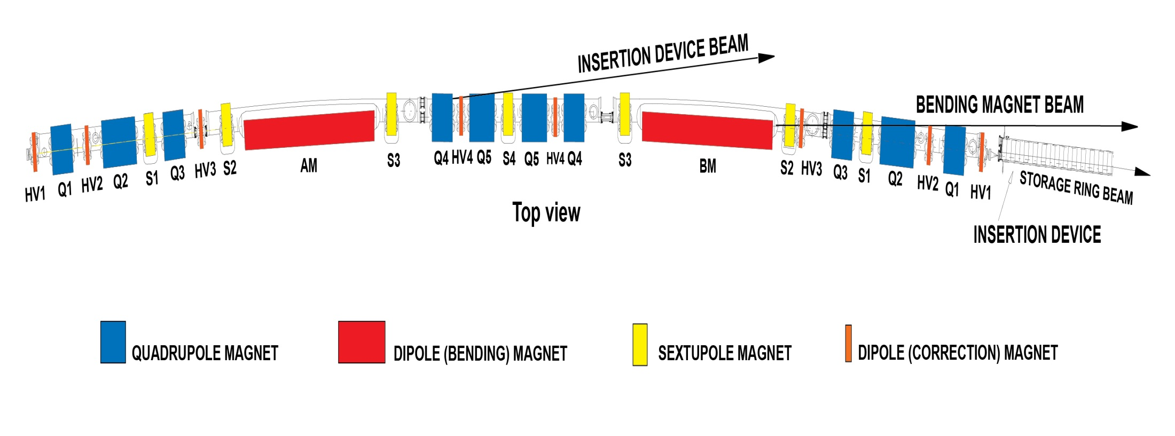
APS – One Sector of the Ring – a Double Bend Achromat

Slide 28
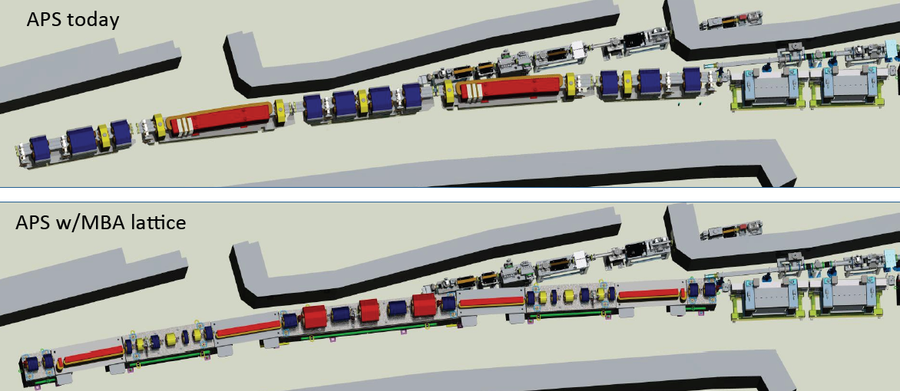
APS-U: 7 Bend Achromat will Replace the 2 Bend Achromat
M. Borland 4/2014

Slide 29
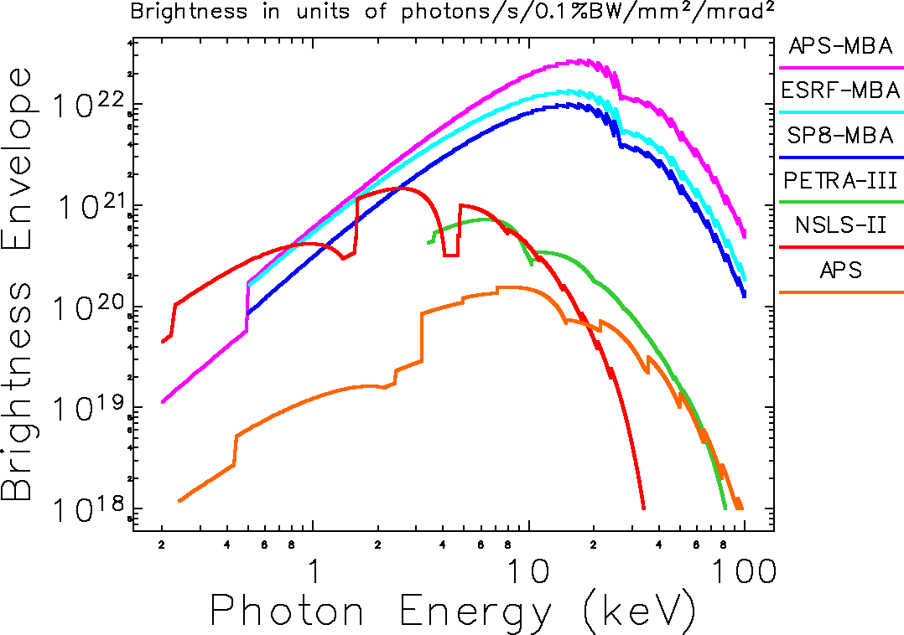

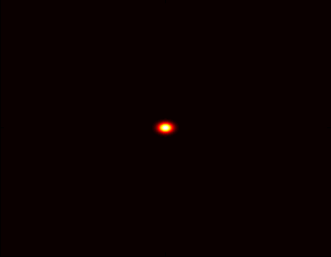
APS-U MBA Brightness Improvement
Dramatically enhance the performance of the APS as a hard x-ray source
3100 pm
natural
emittance
at 7 GeV
APS Now
MBA
67 pm
natural
emittance
at 6 GeV
Particle Beam
Profiles
1 mm
M. Borland 4/2014

Slide 30
Free Electron Lasers

Slide 31
Findings and Recommendations – FELs
Recommendation: The new light source should provide high repetition rate, ultra-bright, transform limited, femtosecond x-ray pulses over a broad photon energy range with full spatial and temporal coherence. Stability and precision timing will be critical characteristics of the new light source.
  The best approach for a light source would be a linac-based, seeded, free electron laser.
  The linac should feed multiple, independently tunable undulators each of which could service multiple endstations.
  The new light source must have pulse characteristics and high repetition rate to carry out a broad range of “pump probe” experiments, in addition to a sufficiently broad photon energy range (~0.2 keV to ~5.0 keV).

Slide 32
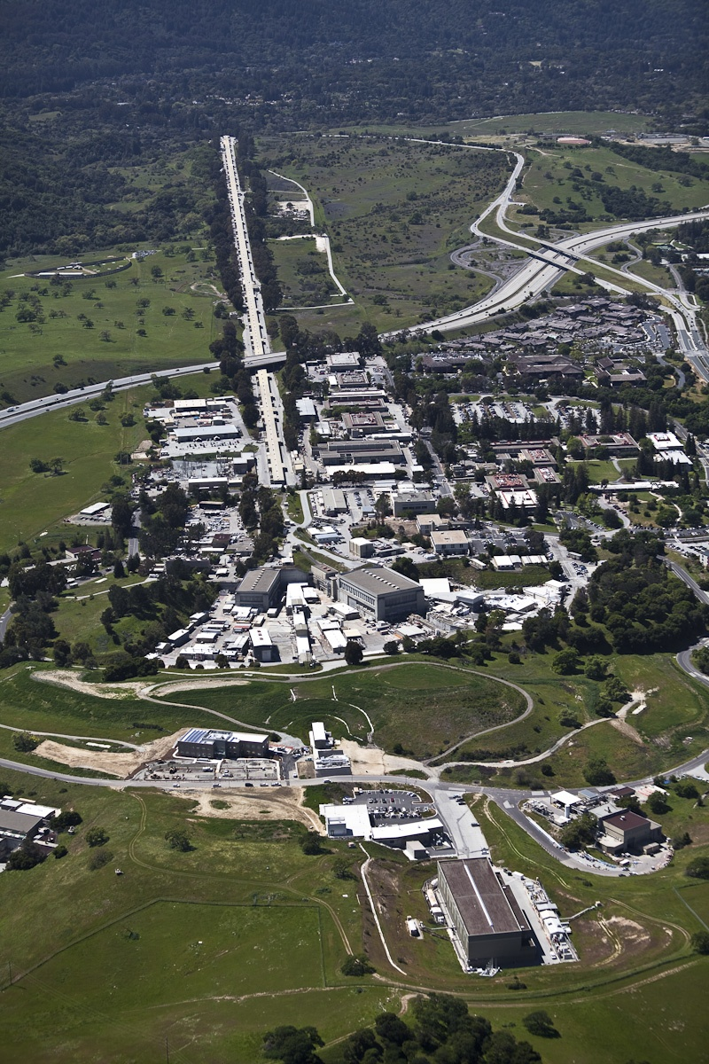
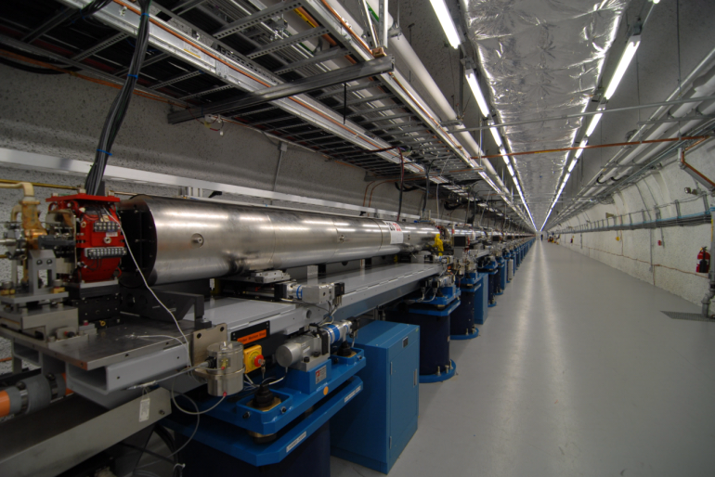
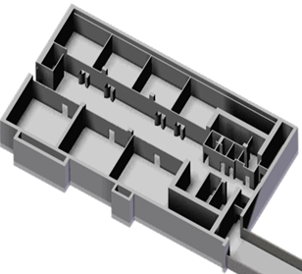
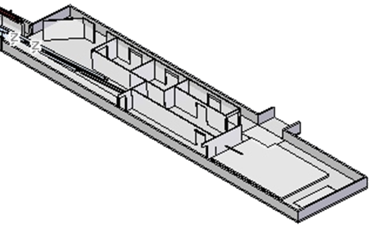
Linac Coherent Light Source (LCLS)
The World’s First X-ray Free Electron Laser
Injector
electron beam
1km linac 14GeV
AMO
Undulator hall
SXR
XPP
Near-hall: 3 stations
x-ray beam
XCS
CXI
Far-hall: 3 stations
MEC

Slide 33
LCLS-II: CW High Rep & High Pulse Energy FEL
 | Recommendation | Implementation
✔ | High Repetition Rate | CW Linac with MHz Capability
✔ | Broad Energy Range | SC & Cu linacs with variable gap undulators
✔ | Transform Limited | Self seeding narrow bandwidth monochromator
✔ | Ultra-Bright | 14.7 GeV linac & high K undulator
✔ | Multiple Undulator Sources | Two undulators
keV

Slide 34
Worldwide Competition

Slide 35
DOE Light Sources & Key Worldwide Competitors
Circa 2014
MAX IV
PSI SLS
PETRA III
PAL XFEL
SWISSFEL
XFEL
ALS
ESRF,U
FLASH-I,II
NSLS-I,II
APS,U
SPRING8,U
SSRL
LCLS-I
SACLA XFEL
LCLS-II
SIRIUS
Storage Rings in Blue
FELs in Red
There are many more UV/X-ray rings, IR/UV FELs & a few ERLs

Slide 36
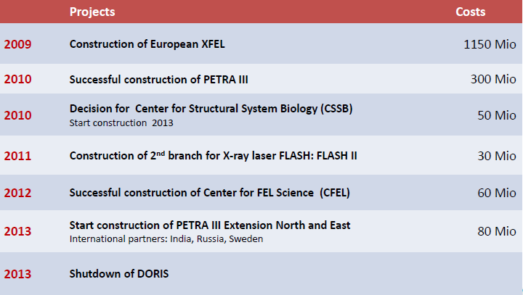
Investments @ DESY Over 5 Years
1 Euro = $1.30
Notes:
Need to get Helmut’s permission to show this….

Slide 37
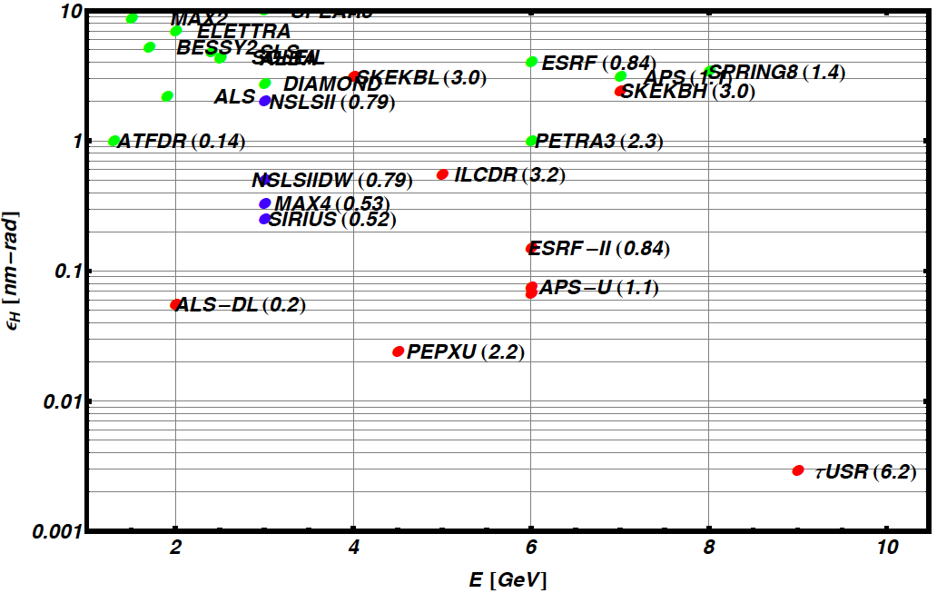
Ring Equilibrium Emittance vs Ring Energy
NSLS2
Ring Name (Circumference in km)
Achieved
APSU
ALSU
Construction
SPRING6 (1.4)
Design
Diffraction Limit @1Å
ε ~ λ/4π ~ 8 pm

Slide 38
Summary Remarks
The BES strategic plan, developed with input from the BESAC Future X-ray Light Sources report, will ensure that the USA light sources will maintain world leadership for decades to come
Strong competition from Asia & Europe on light source facilities will require exceptional quality science to be performed at the USA light sources as the facilities alone will not be sufficient to set the USA apart from the pack
Robust R&D programs on accelerator physics/technology, detectors & optics will be needed to fully leverage the new sources and provide a pathway to the future.

Slide 39
Backup

Slide 40
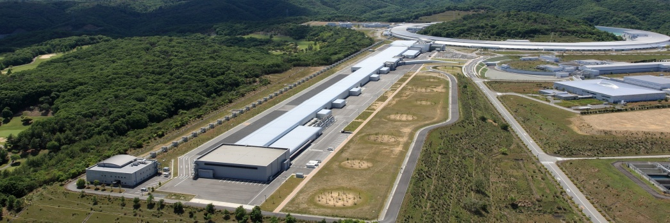
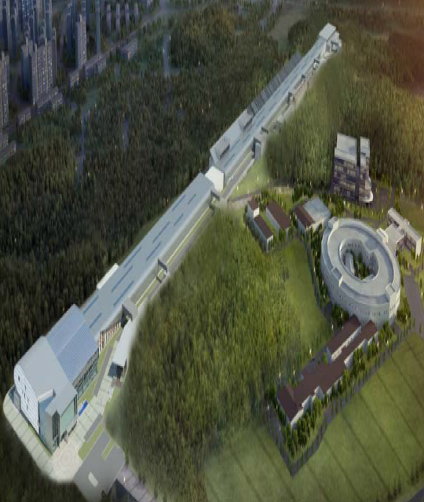
Asian Strategy
Current Status:
  Spring-8: High performing 3rd generation SR
  Many other ‘regional’ storage rings
  SACLA: 60 Hz, one beam line hard x-ray FEL
Near Future:
  Upgrade Spring-8 to ‘USR’
  Upgrade SACLA
    SACLA with additional injector and ** additional undulators
  New FEL in Korea: PAL XFEL
    One beam line, 100Hz
Far Future:
  3 GeV ERL @ KEK
SACLA 2011
8.5 GeV, 60 Hz NC
PAL XFEL 2015
10 GeV, 100 Hz NC

Slide 41
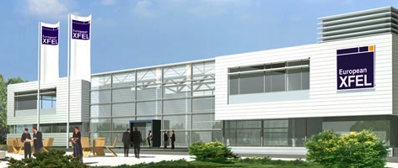
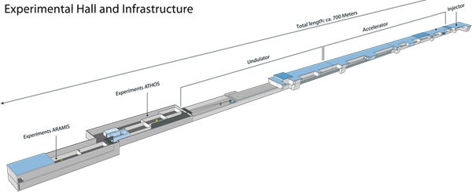
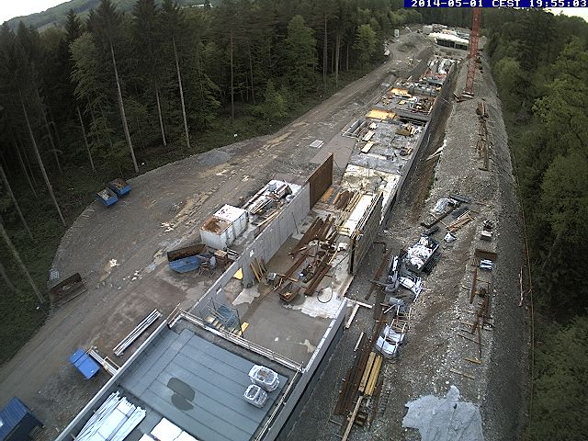
European Strategy
Current Status:
  Several high performance hard-x-ray SR
    ESRF, PETRA-3
  Several high performance soft/medium x-ray SR
    BESSY, SLS, Diamond
  Two soft x-ray FEL’s
    FLASH I & Fermi with1 undulator each
Near Future
  Upgrade ESRF to ‘USR’, build new high performance ring (MAX-4), expand PETRA-3
  Expand FLASH I → FLASH II
  Two new hard x-ray FEL’s:
    XFEL: rep rate 3000 x 10; 6 undulators
    SwissFEL: rep rate 100 Hz and 1 undulators
XFEL 2017
17.5 GeV, 3000 x 10 Hz SC
May 2014
SWISS FEL 2016-7
5.8 GeV, 100 Hz NC

Slide 42



European Strategy (cont’d)
By 2020, Europe will challenge the USA for the most advanced suite of light source tools in the world
Enormous concentration of tools in Hamburg
  FLASH I, II
  PETRA-3
  XFEL (managed by XFEL corporation)
German strategy includes tremendous investments in infrastructure to exploit the light sources and deliver science
  CFEL
  CSSB
  Nanocenter
Nano-Bio-Femto

